Slide 1
DATA CLASSIFICATION AND STORAGE SOLUTIONS
Workshop
June 4, 2020
Annika Rockenberger, University of Oslo Library
Elin Stangeland, Universtiy of Oslo Library
Original presentation by Anne Bergsaker, University Center for Information Technology

Slide 2
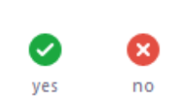
Zoom Feedback Test
Open the menu “Participants” and click on “Yes” in the bottom of the menu. Then click on “No”.

Slide 3
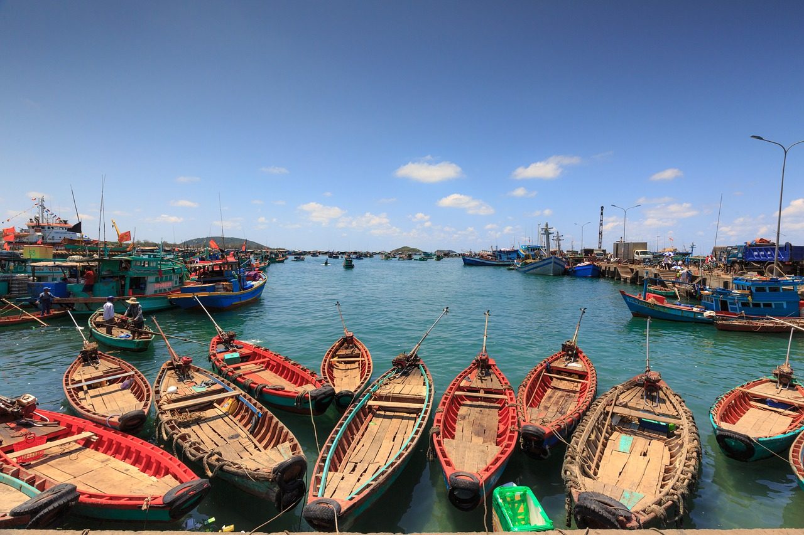
Data Classification

Slide 4
Classifying your data

Slide 5
What is green data
This class is used if it does not cause any harm to the institution if the information becomes known to unauthorized persons.
Any research that is published openly. Information that is not public needs to be removed first.
Teaching material that is not subject to copyright
Completely anonymous data
Data without any financial or commercial value

Slide 6
Question 1
Do you think you will work with green data?

Slide 7
What is yellow data?
This class is used if it could cause a certain damage to the institution if the information becomes known to unauthorized persons.
Documents that you don’t want everyone else to read
De-identified data where the key is locked away and stored safely away from the data
Data sets containing minor amounts of non-sensitive personal data
E-mail attachments that don’t contain information that needs protection
Unpublished research material

Slide 8
Question 2
Do you think you will work with yellow data?

Slide 9
What is red data?
This class is used if it will cause harm to public interests, the university or individuals if the information becomes known to unauthorized persons.
De-identified data where the key is available and stored with the data
Special categories of personal data
Information relating to e.g. safety systems in buildings or IT systems
Health related data

Slide 10
Question 3
Do you think you will work with red data?

Slide 11
What is black data?
This class is used if it could cause significant harm to public interests, the university or individuals if the information becomes known to unauthorized persons.
Research data that requires extra protection
Large quantities of sensitive personal data
Large quantities of health related data
Research data that is of great financial or commercial value

Slide 12
Question 4
Do you think you will work with black data?

Slide 13
You must familiarise yourself with & comply with the data processing guidelines. Consult with your PI, local IT or USIT!

Slide 14
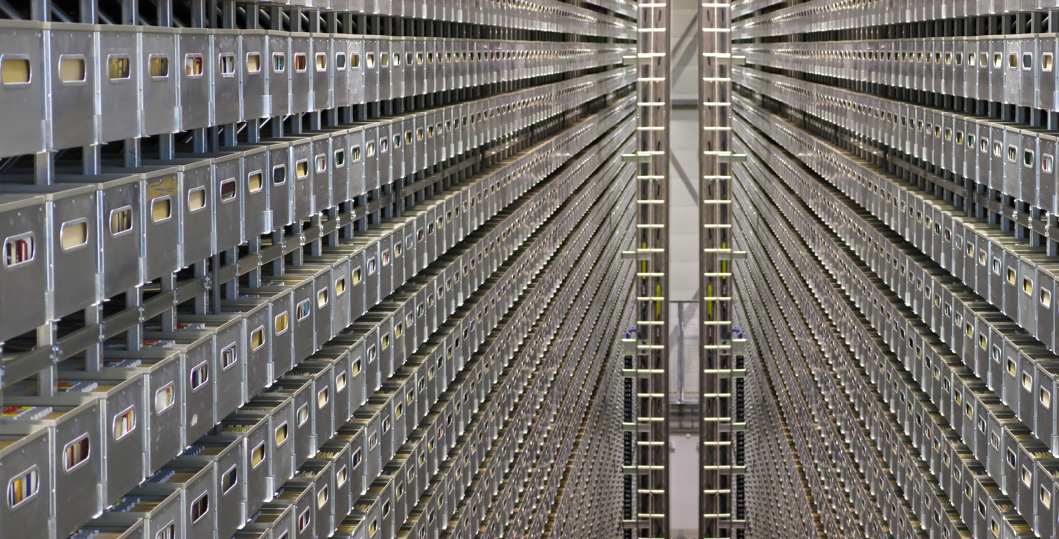
STORAGE SOLUTIONS
Automated Storage Facility at the National Library of Norway. Picture by Tore Brattli. Source https://flic.kr/p/hn3y5D

Slide 15
Question 5
Are you primarily using a private laptop/computer for your research?

Slide 16
Where can you store the different types of data?
Green data: anywhere you want, but ideally not only on your private laptop (very vulnerable)
Yellow data:
encrypted hard drive
UiO cloud solution (UiO OneDrive, UiO G-Suite)
UiO home directory (M: )
UiO storage hotel(«lagringshotell»)
Not your private laptop or phone, unless they are encrypted and safely used

Slide 17
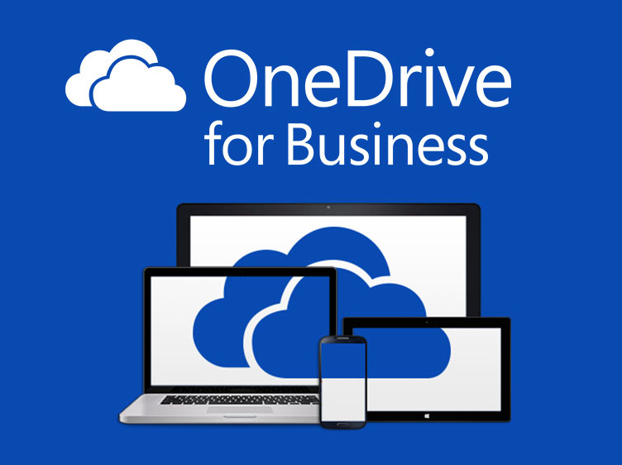
UiO commercial cloud solutions
Microsoft OneDrive + Office365
https://www.uio.no/english/services/it/store-collaborate/o365/
Google Drive + Docs, Sheets, etc
https://www.uio.no/english/services/it/store-collaborate/gsuite/

Slide 18
Question 6
We have shown you UiO‘s commercial cloud solutions, Microsoft OneDrive & Office365 and Google G-Suite.
Are you aware of other commercial cloud solutions that UiO offers?

Slide 19
Where can you store the different types of data?
Red data:
For data that is red, but not highly sensitive:
UiO Storage hotel
UiO maintained encrypted computer without any automatic syncing with home directories or cloud solutions
Red, highly sensitive data:
Services for sensitive data - TSD
Black data: TSD
Source: https://www.uio.no/english/services/it/security/lsis/storage-guide.html

Slide 20
Question 7
Do you think you will be using TSD during your research at UiO?

Slide 21
Storage hotel
Contact local IT for access
Remote disc where you can safely store and access your data
Safer than the cloud solutions, so you can store up to red data
Guidelines on costs and access to storage hotel: https://www.uio.no/english/services/it/store-collaborate/storage-hotel/

Slide 22
Question 8
Do you know where to find contact information for your local IT and the Center for Information Technology?

Slide 23
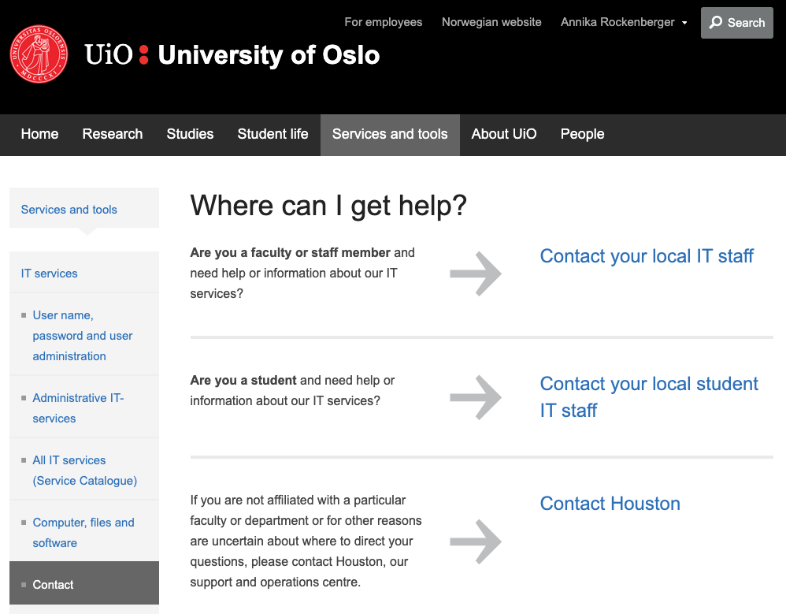
Contact Points for IT at UiO
https://www.uio.no/english/services/it/contact/

Slide 24
Question 9
Do you have a routine for making backups for your research files (manuscripts, data, etc.)

Slide 25
Storage solutions and backup
Use safe storage solutions, where data/files are backed up
Always keep a copy of your raw data material safely hidden away (like a folder on storage hotel that you never edit)
Only saving files on your own computer is not safe!
A memory stick or an external harddrive is not safe!
How much extra work would it be for you to recreate your data or your work?

Slide 26
Save all the files!
«For every result, keep track of how it was produced» (Sandve et al, 2013)
Save processed data at important stages in the project
Save processed data and analysis/methods for every table and graph

Slide 27
Useful links
Data management at UiO:
https://www.uio.no/english/for-employees/support/research/research-data-management/
The UiO data storage guide: https://www.uio.no/english/services/it/security/lsis/storage-guide.html
Data classification guide: https://www.uio.no/english/services/it/security/lsis/data-classes.html

Slide 28
And Questions…!

