Slide 1
Data management planning at UiO
What is a data management plan?
What should your data management plan contain?
Slides created by Elin Stangeland and Marianne Inez Lien

Slide 2
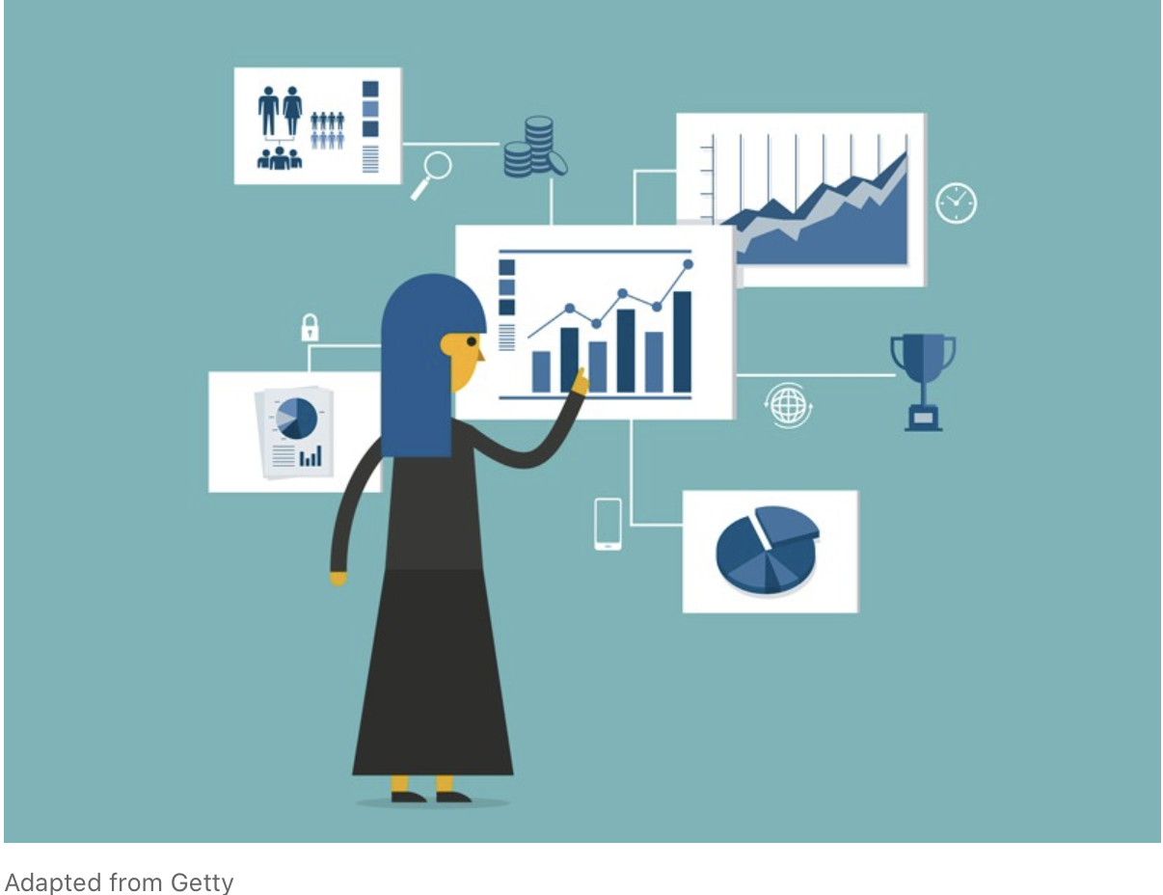
Agenda
13:00 - 14:00
Introduction to
data management plans (DMP)
What should a DMP contain?
14:00 - 14:30
Q&A

Slide 3
Learning goals
After the course, you:
Will be familiar with the concept of the data management plan
Know the UiO requirements for data management planning
Know how to create a data management plan for your project(s)

Slide 4
Data management planning
Data management – brief background
Research life ycle
FAIR
What is a data management plan?
Why do you need one?
Personal motivations
Requirements – UiO policy and mention NFR - EU
What tools and help services do resarchers have access to for help?

Slide 5
Source: UiT: https://uit.no/forskning/art?dim=236443&p_document_id=521580

Slide 6
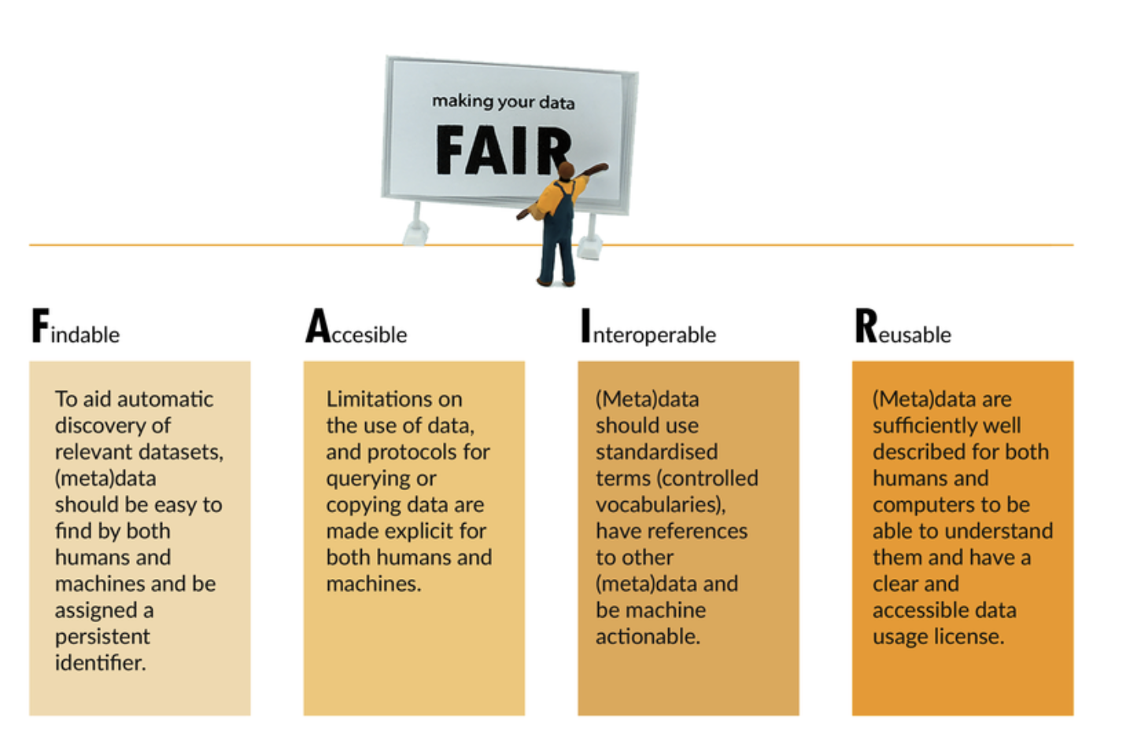

Slide 7
What is a Data Management Plan (DMP)?
A DMP is a document that describes how research data is to be managed both during a research project and after it has been completed

Slide 8
Why do you need a DMP?
By planning well you can save time​
Research project planning will get easier​
-Identifying resource requirements​
-Easier to identify time dependencies or problems​
Keep track of your data throughout and after your project​
When applying for funding, having a DMP will be beneficial​
Make your data FAIR and reusable​
Comply with any funder requirements​
If/when sharing data gives you credit in research assessment schemes and when seeking career opportunities

Slide 9
UiO guidelines
Research data shall be provided with a data management plan
The DMP is a document that describes how the data is to be managed both during the research project and after it has been completed
The DMP shall describe how the data should be made available in accordance with international standards
The scientific staff shall have a conscious attitude as to how research data considered as not having long-term value should be managed or destroyed after a certain period of time
Source: https://www.uio.no/english/for-employees/support/research/research-data-management/policies-and-guidelines/

Slide 10
Tools and support
Personal data – the Norwegian Centre for Research data template: https://nsd.no/datahandtering/datahandteringsplan
EU funding – DMPonline: https://dmponline.dcc.ac.uk/
Life science focus – Elixir Data Stewardship wizard: https://elixir.no/Services/data-management/data-stewardship-wizard
Sigma2s EasyDMP might be worth checking out: https://www.sigma2.no/data-planning

Slide 11
Examples of DMPs
Synthetic Chemistry / EPSRC from University of Glasgow https://www.gla.ac.uk/media/Media_418166_smxx.pdf
PhD Ecology / Lincoln University, New Zealand https://riojournal.com/article/8664/

Slide 12
Resources
UiO resources for data management – including the policy: https://www.uio.no/english/for-employees/support/research/research-data-management/
FAIR principles: https://www.go-fair.org/fair-principles/
Further readings:
About DMP from Nature: https://www.nature.com/articles/d41586-018-03071-1
Michener, W.K. (2015) Ten Simple Rules for Creating a Good Data Management Plan. PLoS Computational Biology 11(10): e1004525. https://doi.org/10.1371/journal.pcbi.1004525

Slide 13
Adapt Your Data Management Plan
The following slides contain an outline for a general DMP as it is required by
Some funding agencies have their own templates and specifications, but address the same topics.
These slides have been made by Annika Rockenberger and Marianne Inez Lien
Notes:
These slides have been made by Annika Rockenberger and Marianne Inez Lien
Additional annotations by Elin Stangeland and Marianne Inez Lien
The next part of the course will be a practical and informative guidence into the concrete plan. I recommend you to take notes so you can start making your DMP as we speak or you can fill inn the missing pieces of the plan that you already started.

Slide 14
Remember that the DMP is first and foremost a document for yourself, accompanying a project outline and description​

Slide 15
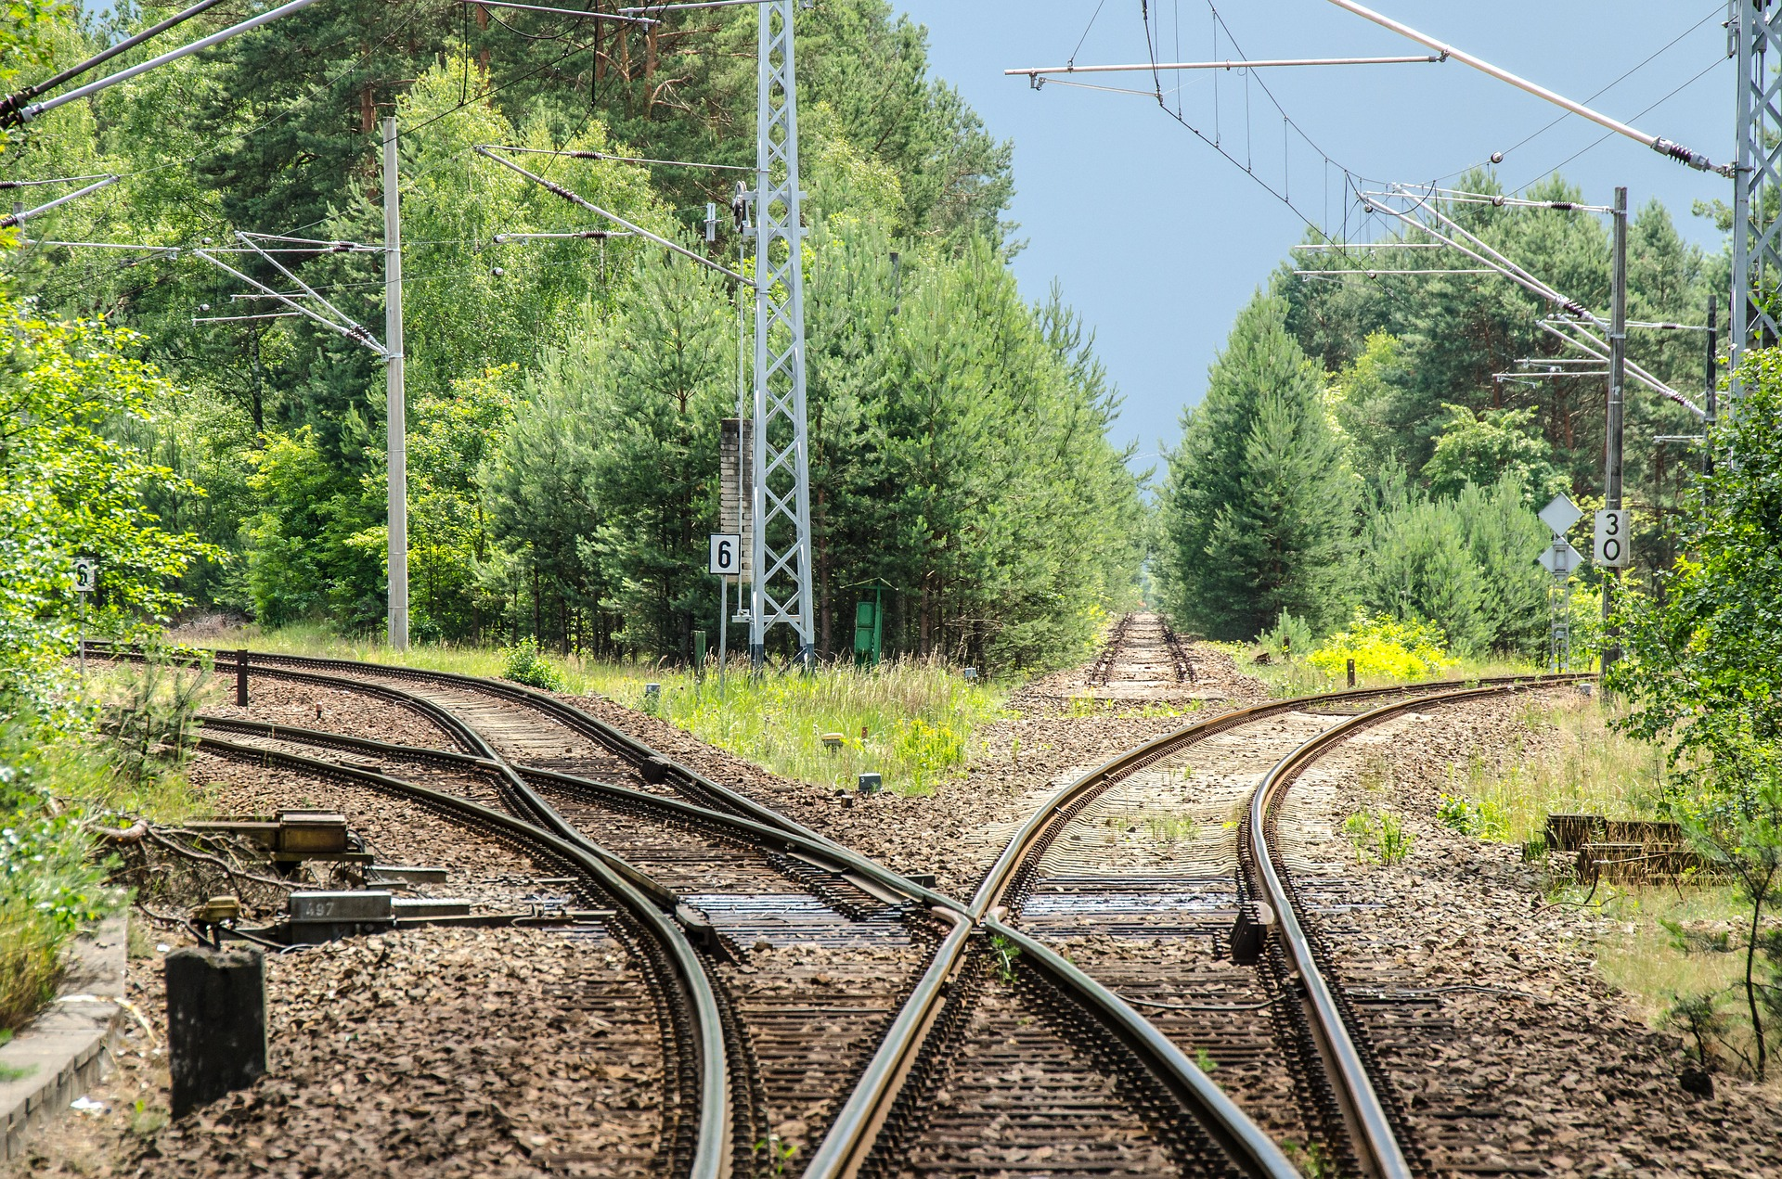

Slide 17
WHAT DO I INCLUDE IN A Data management plan?

Slide 18
General Information
Title and project number
Part of a larger project? Title and project number
Responsible for the data management plan (name)
Principal investigator and project member(s)
Faculty- and departmental affiliation
Brief project description
Project period
Financing
Data Management Plan version and date

Slide 19
Data Description
Origin of Data What kind of data will be used during the project? If data is reused: What is the scope, volume, format? How are different data sources integrated? If new data is collected, why is this necessary?
Data Collection How will data be collected? Is specific software or hardware – or staff required? Who is responsible for data collection? During which period will data be collected? Where will data be collected?
Types of Data What type(s) of data will be collected? What is the scope, quantity and format of the material? What is the total amount of data collected (MB/GB/TB/PT)?

Slide 20
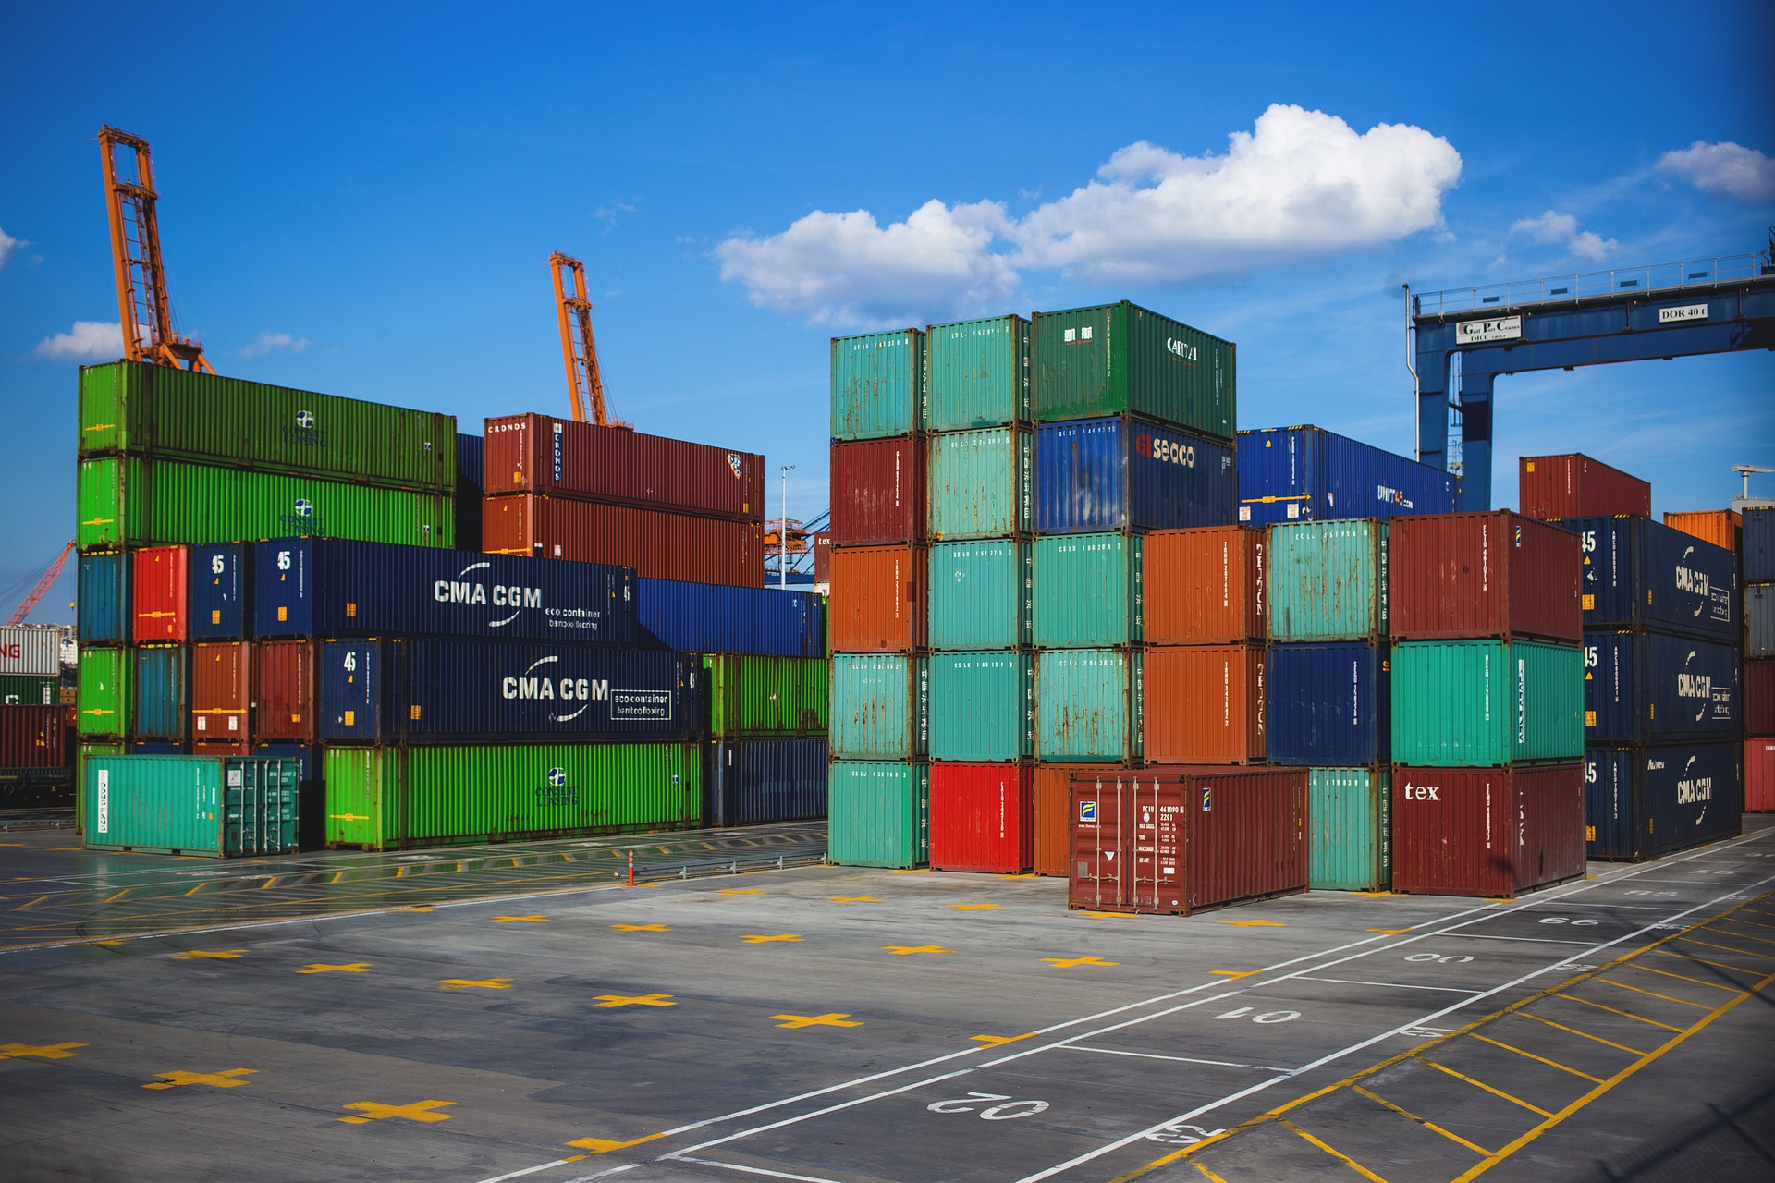
Storage and security
Where will you store your data?

Slide 21
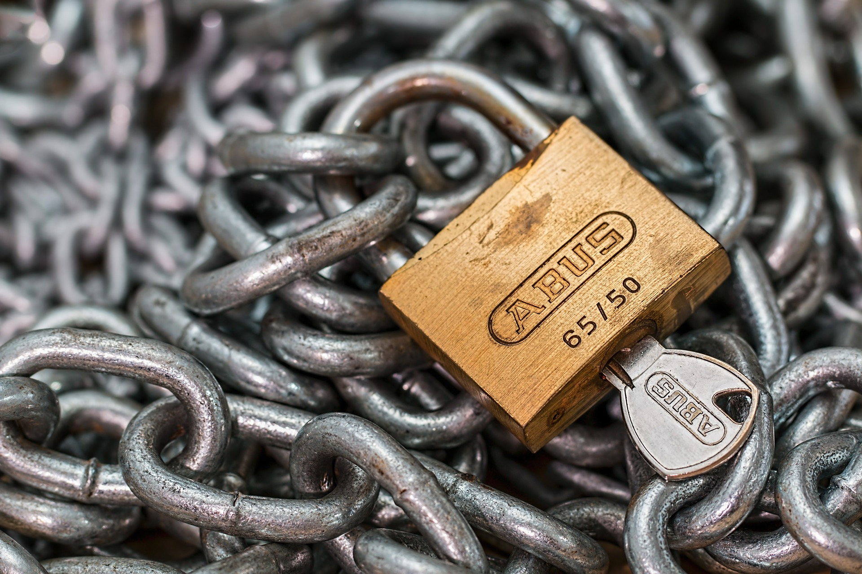
Access
Who should have access to the data throughout the research project?
How will access be managed?
Who is responsible for managing access?

Slide 22
Organisation and Documentation
Data Organisation How will you organise your data? Will data be organised in simple files or databases? How will data quality during the project be ensured? If data consists of many different file types, how will you structure the data?
File Structure & Names How will you structure and name folders? How will you structure and name files?
Documentation How will the data be documented so that they are comprehensible and reusable for yourself and others, also in the long term? How will documentation be structured?
Metadata What kind of metadata will be provided with the collected/generated/reused data? How will metadata for each object be created? (If applicable) What metadata standard(s) will you use?

Slide 23
Legal and Ethical Aspects
How are you planning to safeguard that any legal requirements are met when managing research data? E.g. when it comes to managing privacy aspects, confidentiality and intellectual property?
It is always important to think through the ethics aspects of you research in relation to the collection and sharing of data. How will you ascertain that ethical principles for research are followed throughout the project?
Are you planning to apply a license to some, or all of your data? Which license do you intend to use?

Slide 24
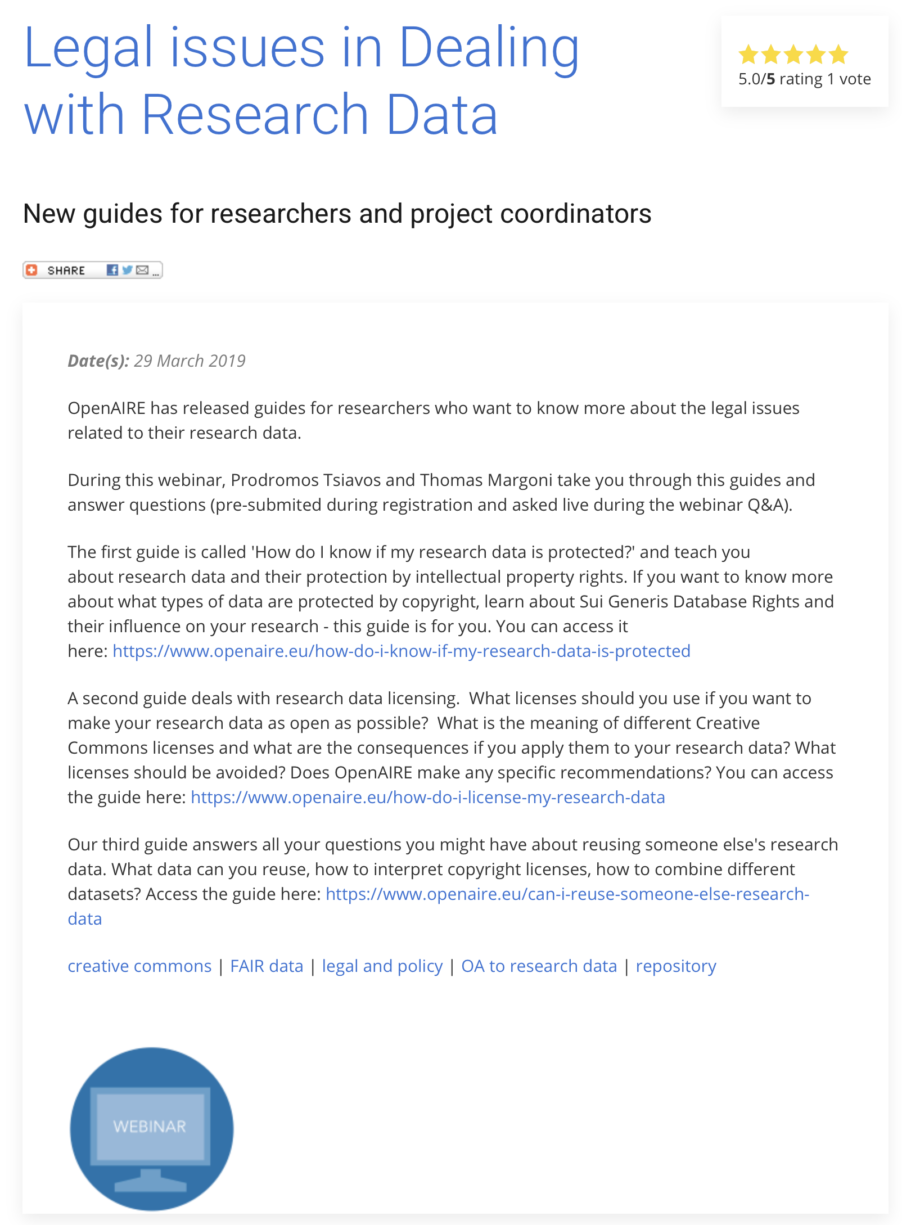
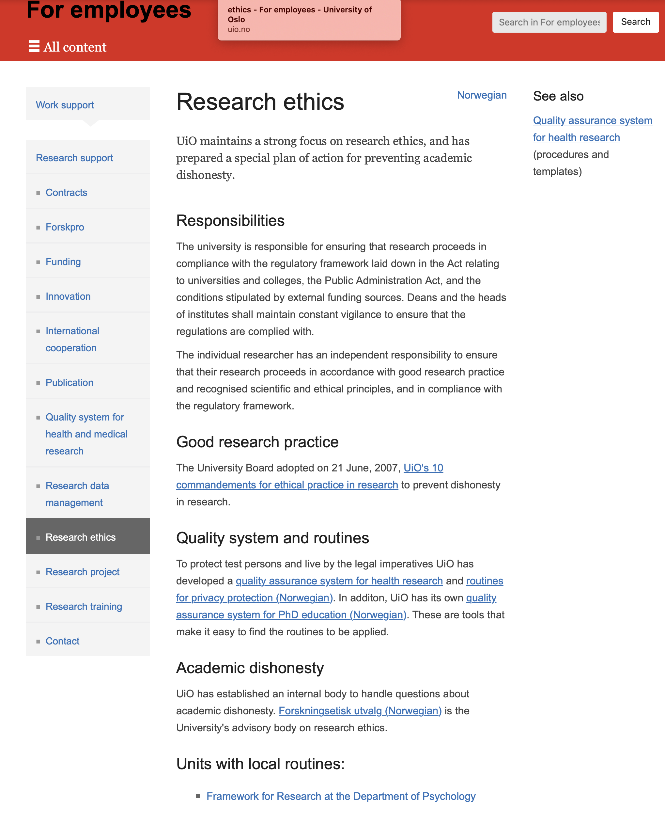
Here you can read more about licencing
Here you can read more about legal requirements
https://www.uio.no/for-
Source: https://www.uio.no/for-ansatte/arbeidsstotte/fa/regelverk-og-forskningsetikk/etikk/index.html
Source: https://www.openaire.eu/research-data-how-to-license/

Slide 25
https://www.openaire.eu/research-data-how-to-license/

Slide 26
Sharing and Archiving
Afterlife of Data Will your data (have to) be deleted after the project is finished? If it is to be kept, for how long?
Sharing Can your data be shared openly? If it is sensitive, can it be shared under certain restrictions?
Archiving If the data is kept and can be shared, in which archive be stored?

Slide 27
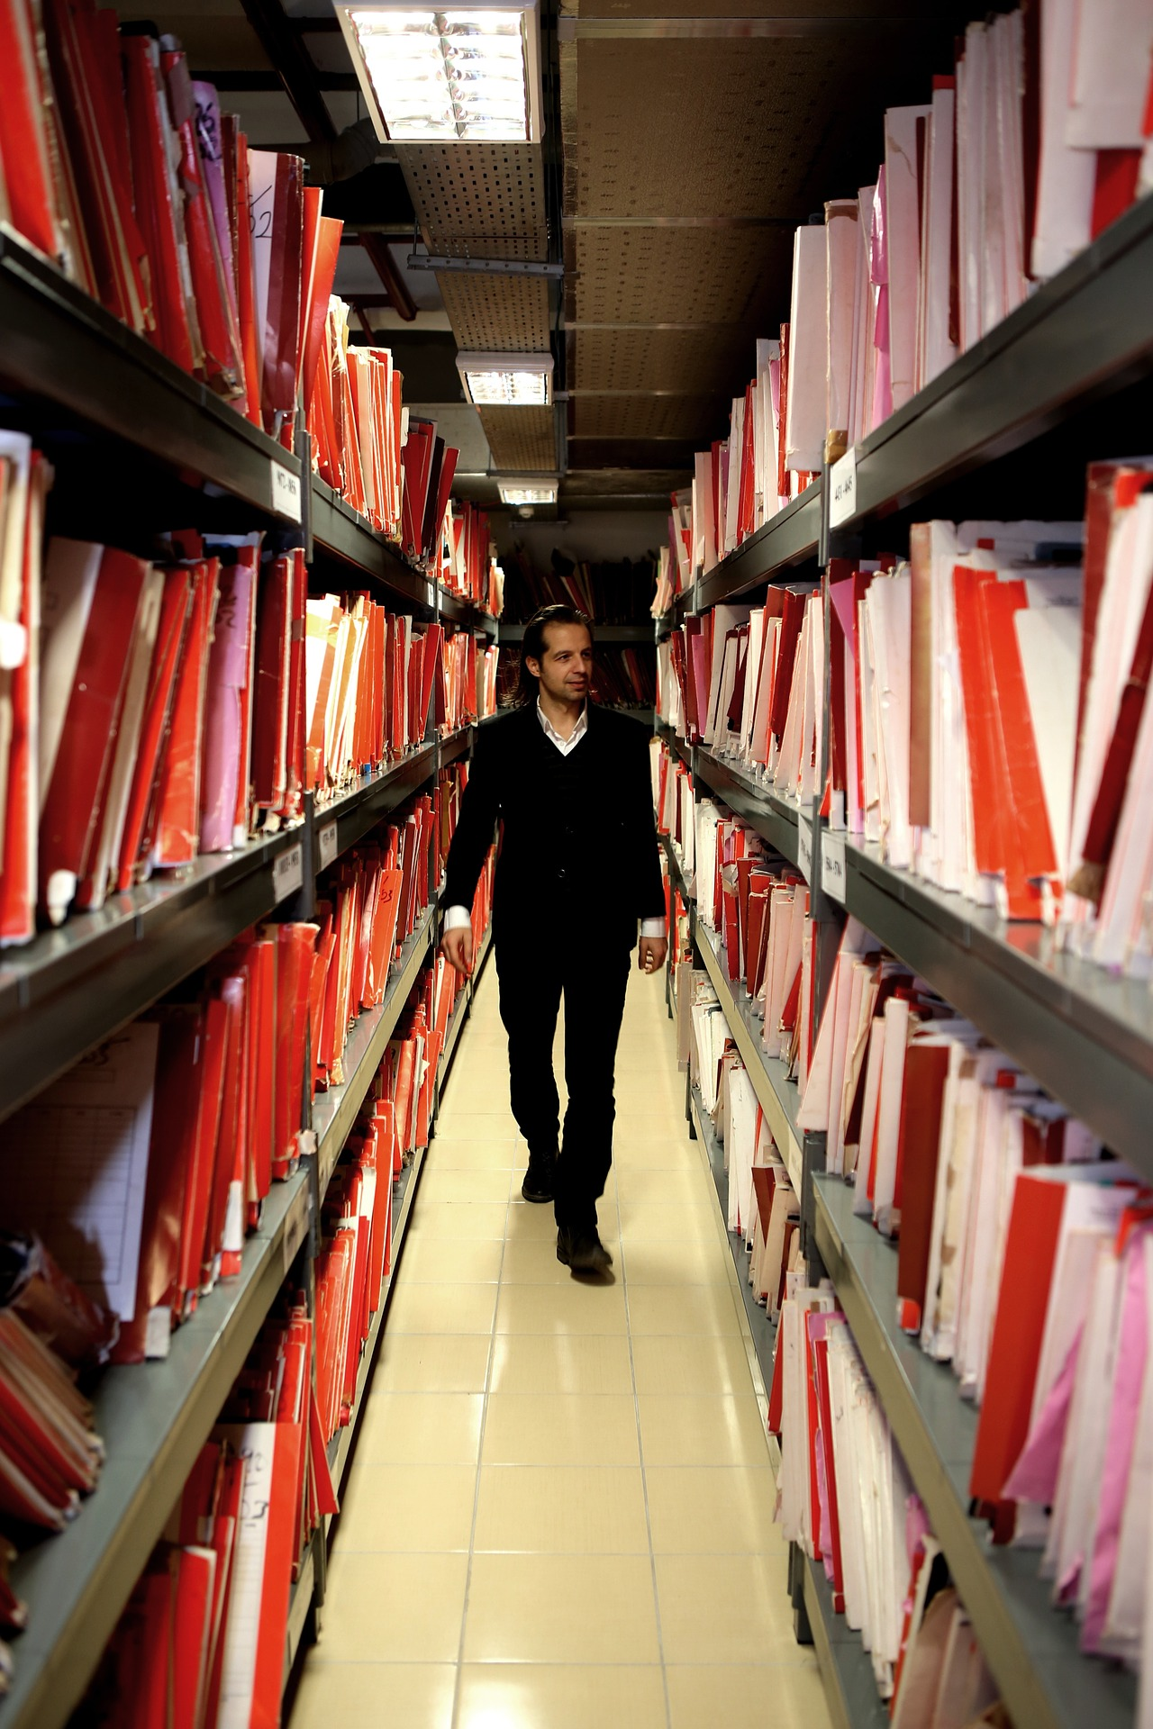
List of archives:
re3data.org a global list of archives
Zenodo EU’s archive
NSD national archives
The Norwegian e-infrastructure for research & Education:
national archives
DataverseNO national archive

Slide 28
Responsibilities and Resources
Who is responsible for data management throughout the project period?
Who is responsible for data management and archiving after the project is finished?
What resources (including costs, etc.) are needed for data management (including storage, backup, access management and clean-up activities for long term storage/archiving)?
What resources are needed throughout the project?

Slide 29
From: https://dmponline.dcc.ac.uk/public_plans

Slide 30
Times change – projects change ...
Adapt your DMP regularly

Slide 32
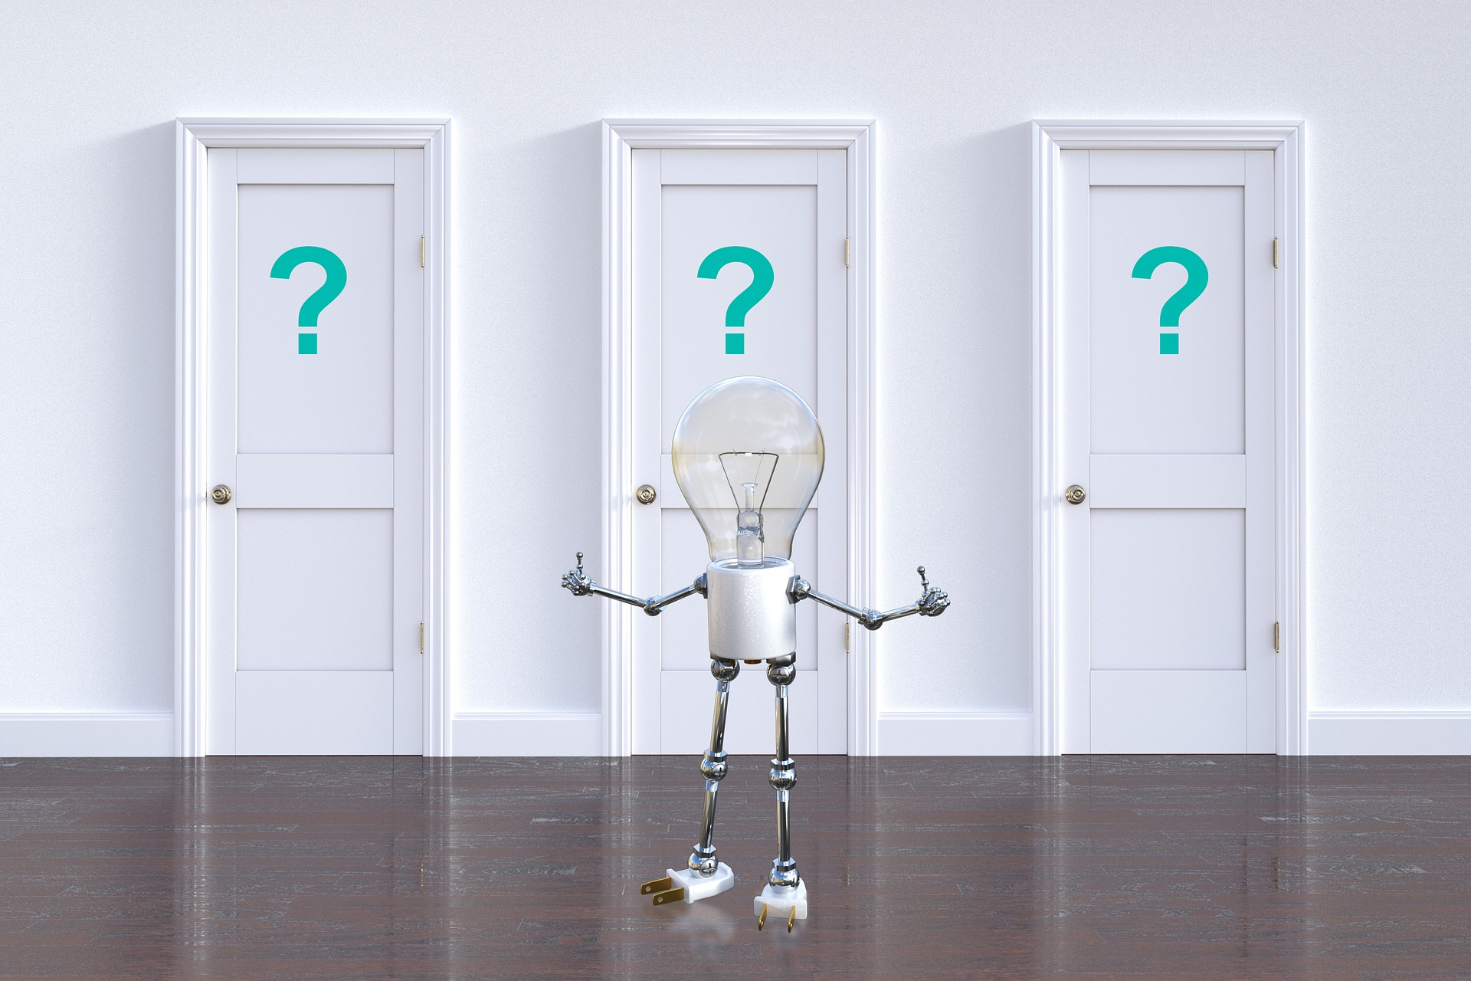

Slide 33
Contact us at: research-data@uio.no

