Slide 1
Data management planning at UiO
What is a data management plan?
What should your data management plan contain?
Slides created by Marianne Inez Lien & Elin Stangeland

Slide 2
Agenda
9:00 - 10:00
Introduction to
data management plans (DMP)
What should a DMP contain?
Short break (5 min)
10:05 - 10:30 Questions & Answers

Slide 3
Learning goals
After the course, you:
Will be familiar with the concept of the data management plan
Know the UiO requirements for data management planning
Have knowledge enough to get started to create a data management plan for your project(s)

Slide 4
Data management planning
Data management – brief background
What is a data management plan?
Why do you need one?
The UiO template
Tools and help services for researchers

Slide 5
Source: El-Gebali, Sara. (2020). Research Data Life cycle. Zenodo. http://doi.org/10.5281/zenodo.4057867

Slide 6
What is a Data Management Plan (DMP)?
A DMP is a document that describes how research data is to be managed both during a research project and after it has been completed

Slide 7
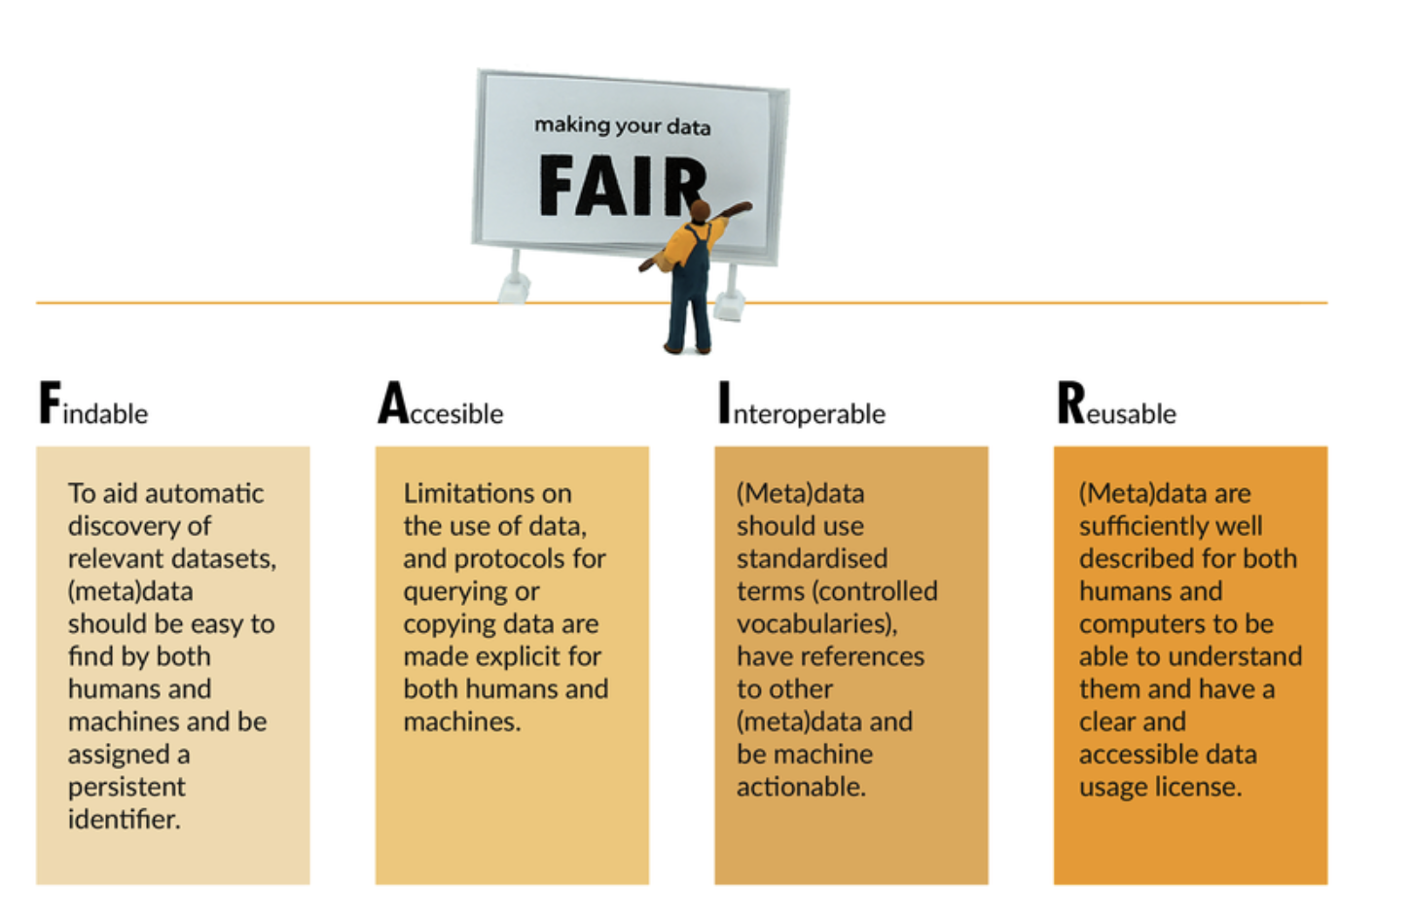

Slide 8
https://ec.europa.eu/research/participants/data/ref/h2020/grants_manual/hi/oa_pilot/h2020-hi-oa-data-mgt_en.pdf

Slide 9
Why should you write a DMP?

Slide 10
By planning well you can save time​
Research project planning will get easier​
-Identifying resource requirements​
-Easier to identify time dependencies or problems​
Keep track of your data throughout and after your project​
When applying for funding, having a DMP will be beneficial
Make your data FAIR and reusable​
Comply with any funder requirements​
Relationship between research impact and data management
If/when sharing data gives you credit in research assessment schemes and when seeking career opportunities

Slide 12
Different templates
If your project is subject to notification to NSD we recommend you to use the NSD template.
If your project is funded by Horizon 2020 we recommend you to use the EU template in DMPonline.
For all other projects we recommend you to use the UiO template

Slide 13
Adapt Your Data Management Plan
The following slides contain an outline for a general DMP as it is required by
Some funding agencies have their own templates and specifications, but address the same topics.
​
These slides have been made by Annika Rockenberger and Marianne Inez Lien

Slide 14
UiO guidelines
Research data shall be provided with a data management plan
The DMP is a document that describes how the data is to be managed both during the research project and after it has been completed
The DMP shall describe how the data should be made available in accordance with international standards
The scientific staff shall have a conscious attitude as to how research data considered as not having long-term value should be managed or destroyed after a certain period of time
Source: https://www.uio.no/english/for-employees/support/research/research-data-management/policies-and-guidelines/

Slide 15
WHAT DO I INCLUDE IN A Data management plan?

Slide 16
General information
Title and Project Number:
Part of a larger research project? Main Project Title and Project Number:
Data Management Plan Owner (name):
Project Leader and Participants:
Affiliated Faculty and Institute:
Collaborating Institutions:
Project Description (brief):
Project Period:
Source of Financing:
Data Management Plan Version and Date:

Slide 17
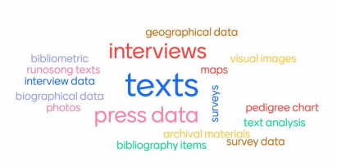
Description and Collection of Research Data
What kind of data will be collected or generated?
How will the data be collected?

Slide 18
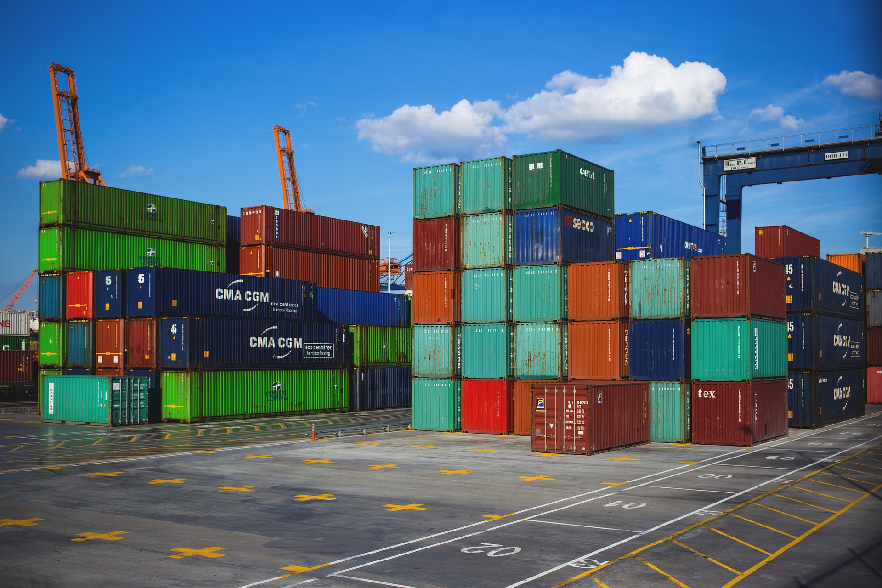
Storage and Security
Where will data be stored?
https://www.uio.no/english/services/it/security/lsis/storage-guide.html

Slide 19
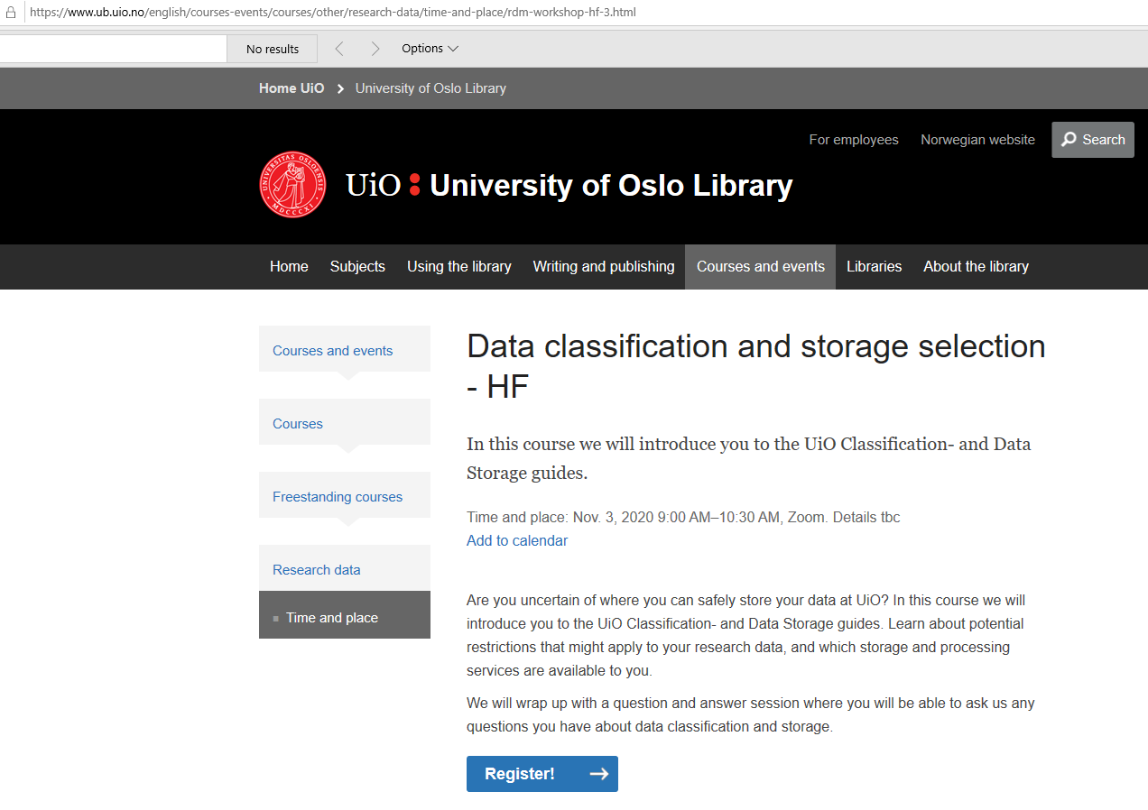

Slide 20
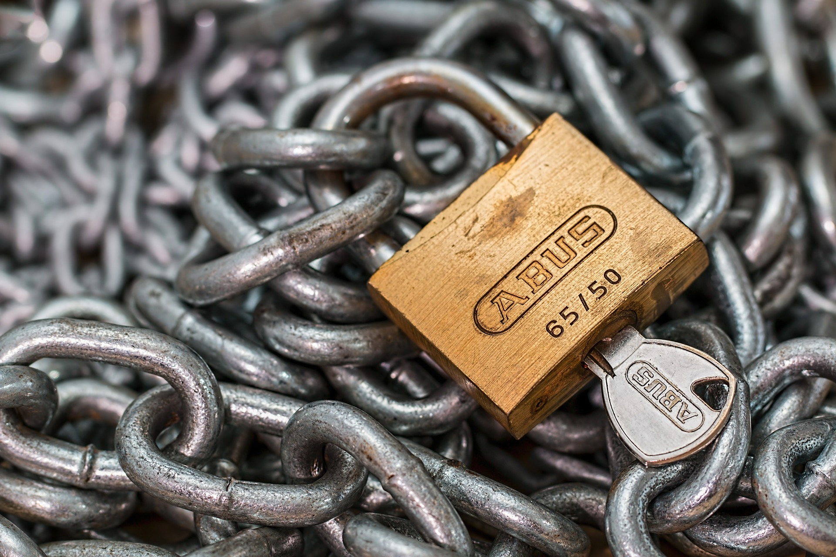
Access
Who will need access to the data during the research project?
How will access to the data be controlled?
Who is responsible for controlling access?

Slide 21
Organisation and Metadata – Documentation and Data Quality
Describe routines for how data will be documented during the project
Will you use an existing metadata standard? If yes, which standard?

Slide 22
Metadata???
Useful links:
https://www.openaire.eu/what-is-metadata &
metadata standards humanities: https://tei-c.org/

Slide 23
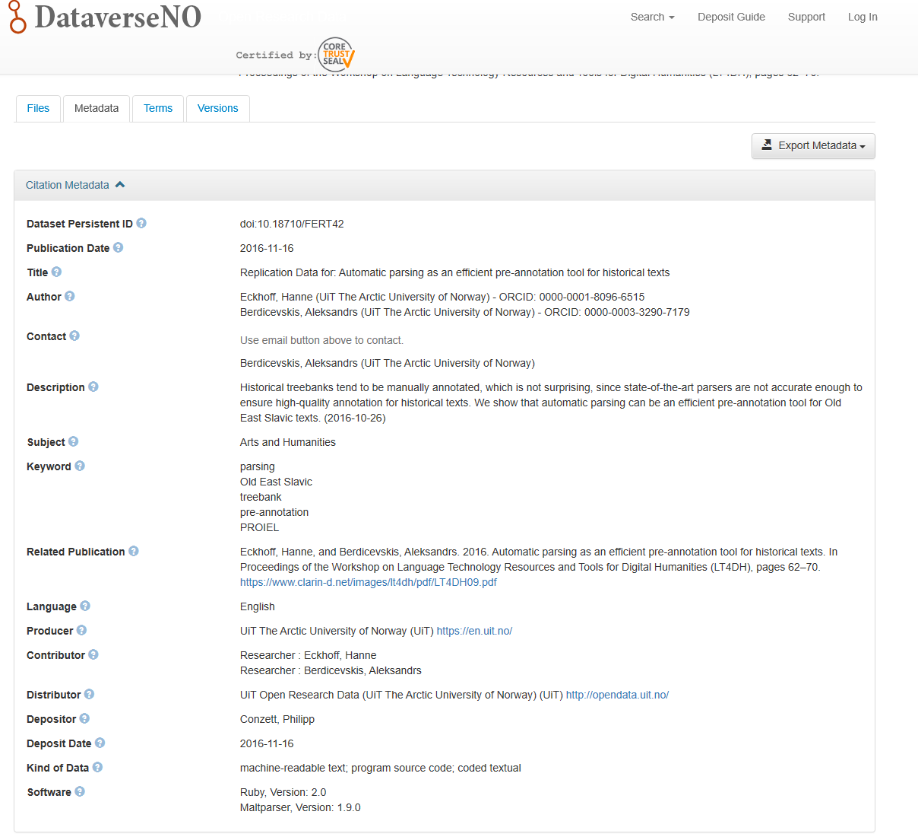
Notes:
DataverseNO (https://dataverse.no/) is a national, generic repository for open research data from researchers from Norwegian research institutions.

Slide 24
https://dans.knaw.nl/en/about/services/easy/information-about-depositing-data/before-depositing/file-formats?set_language=en

Slide 25
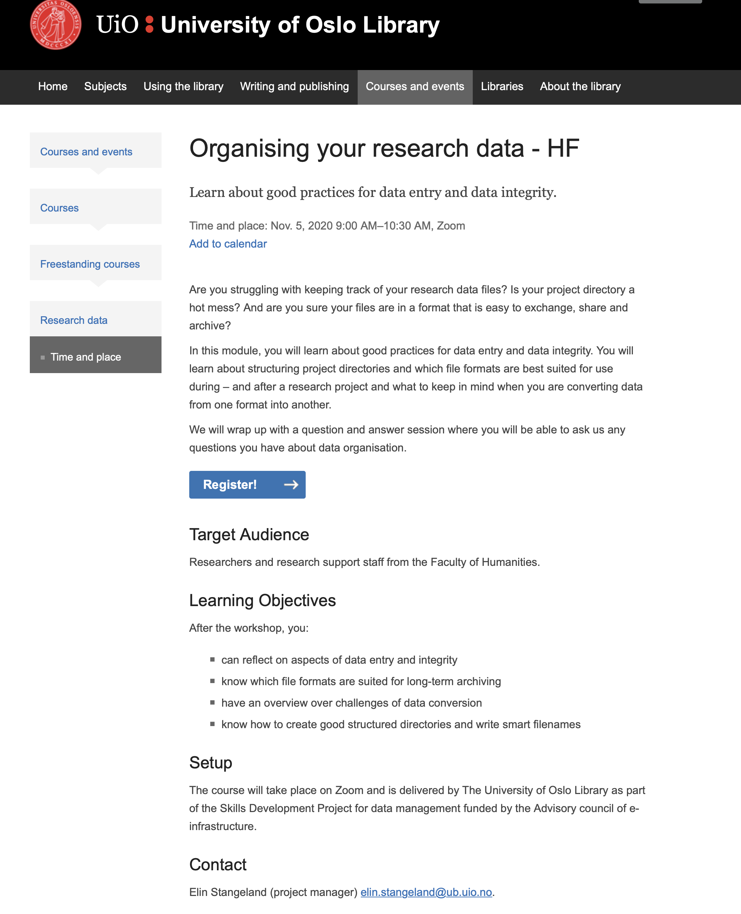

Slide 26
Legal and Ethical Aspects
How will you ensure that data management is conducted in accordance with legal requirements regarding privacy, confidentiality, and intellectual property rights?
It is always important to think ethics in relation to both the collection and sharing of data. How will you ensure that data management is conducted ethically?

Slide 28
Legal and Ethical Aspects - Licensing
Have you considered licensing your data for reuse?
If yes, what license will you use?
Useful link: https://www.openaire.eu/guides

Slide 29
Sharing and Archiving
Which archive are you planning to use to archive your research data?
Can your data be shared openly or should access be restricted?
To what degree can you share your data?

Slide 30
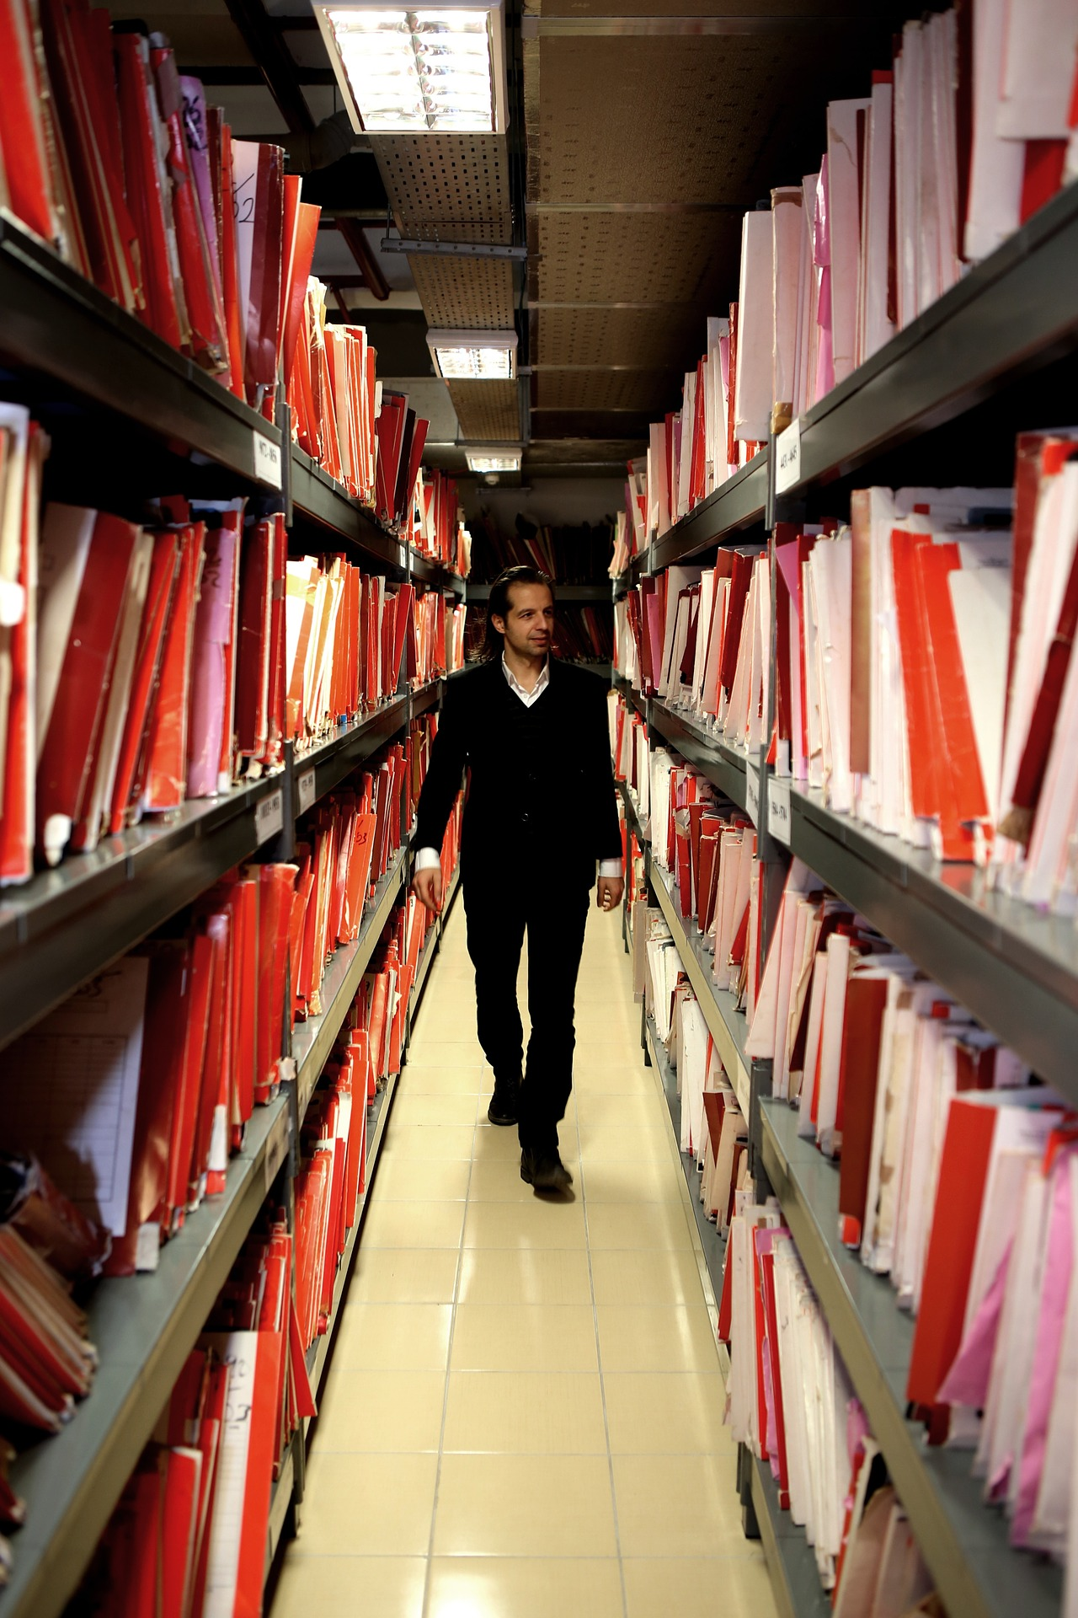
List of archives:
re3data.org a global list of archives
Zenodo EU’s archive (generic service)
NSD national archive
The Norwegian e-infrastructure for research & Education national archive (sigma2)
DataverseNO national archive delivered from the UiT

Slide 31
What archived data can look like
https://dataverse.no/dataset.xhtml?persistentId=doi:10.18710/CZRKNZ

Slide 33
Responsibilities and Resources
Who has ultimate responsibility for managing research data during the project period?
Who has responsibility for managing and archiving the data after the project ends?
Which resources (costs, FTEs, or others) are required for data management in your project? This can include data storage, backups, access to and services related to long-term storage or archiving, and more
What resource are needed while the project is active?

Slide 34
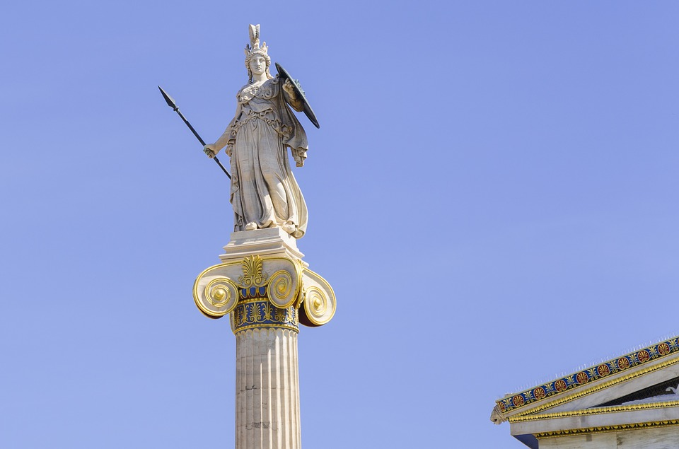
DMP examples in humanities/social science
Horizon 2020 template users:
https://dmponline.dcc.ac.uk/plans/12379/export.pdf
https://dmponline.dcc.ac.uk/plans/39628/export.pdf
University of Leeds
https://www.dcc.ac.uk/sites/default/files/documents/adocs/Leeds-RoaDMaP-DMPs.pdf
University of Bristol
https://www.dcc.ac.uk/sites/default/files/documents/adocs/AHRC_Databris_Religion_DMP.pdf

Slide 35
Tools and support in writing your DMP
UiO resources for data management – including the policy: https://www.uio.no/english/for-employees/support/research/research-data-management/
International Networks for Data Management in the Humanities and Social Sciences Research Data Alliance https://www.rd-alliance.org/
DARIAH-EU Working Group Research Data Management https://www.dariah.eu/activities/working-groups/research-data-management/
CESSDA Data Management Expert Guide:
https://www.cessda.eu/Training/Training-Resources/Library/Data- Management-Expert-Guide

Slide 36
Other resources
Sigma2s EasyDMP is a service that offers researchers, with minimal experience in data management, a simple way of creating a DMP: https://www.sigma2.no/data-planning
The Norwegian Research Council practical guide to Data Management: https://www.forskningsradet.no/contentassets/e4cd6d2c23cf49d4989bb10c5eea087a/se_rdm_practical_guide_final.pdf
Further readings:
Michener, W.K. (2015) Ten Simple Rules for Creating a Good Data Management Plan. PLoS Computational Biology 11(10): e1004525. https://doi.org/10.1371/journal.pcbi.1004525
Corti, L., Eynden, V., Bishop, L., Woollard, M., Haaker, M., & Summers, S. (2019). Managing and sharing research data : A guide to good practice (2nd ed.). Los Angeles: SAGE
.

Slide 37
https://www.uio.no/english/for-employees/support/research/research-data-management/

