Slide 1
Data management planning at UiO
What should your data management plan contain?
Annika Rockenberger
Edina Pozer
Marianne Inez Lien
Elin Stangeland
University of Oslo Library

Slide 2
Agenda
Menti
Introduction to data management plans (DMP)
What should a DMP contain?
11.00 5 min pause
11:00 – 11:30 Q&A

Slide 3
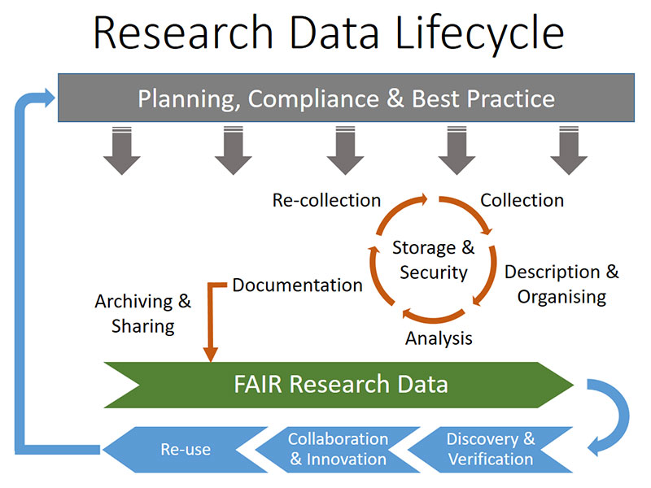
Source: UiT: https://uit.no/forskning/art?dim=236443&p_document_id=521580

Slide 4
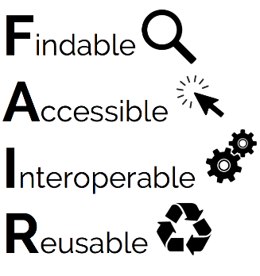

Slide 5
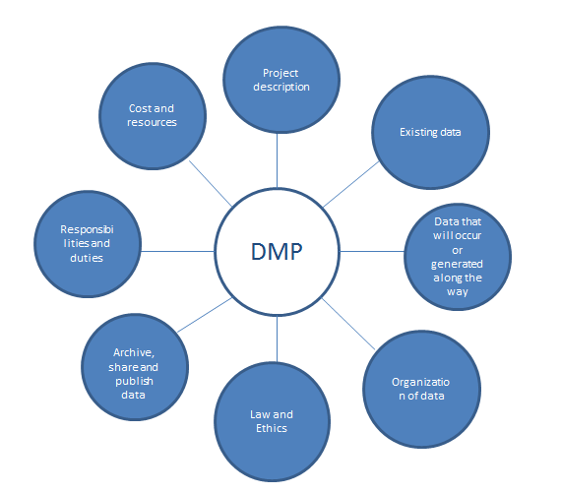
What is a Data Management Plan (DMP)?
A DMP is a document that describes how research data is to be managed both during a research project and after it has been completed

Slide 6
Why do you need one?
By planning well you can save time
Keep track of your data throughout and after your project
Research project planning will get easier
Identifying resource requirements
Easier to identify time dependencies or problems
When applying for funding, having a DMP will be beneficial
Make your data FAIR and reusable
Comply with any funder requirements
If/when sharing data gives you credit in research assessment schemes

Slide 7
UiO guidelines
2.Research data shall be provided with a data management plan
The data management plan shall describe how to make the data available in line with the FAIR principles
The data management plan shall address how data that are considered to have a long-term value should be managed.
The scientific staff shall have a conscious attitude as to how research data considered as not having long-term value should be managed or destroyed after a certain period of time
Source: https://www.uio.no/english/for-employees/support/research/research-data-management/policies-and-guidelines/

Slide 8
Tools and support
Personal data – the Norwegian Centre for Research data template: https://nsd.no/datahandtering/datahandteringsplan
EU funding – DMPonline: https://dmponline.dcc.ac.uk/
Life science focus – Elixir Data Stewardship wizard: https://elixir.no/Services/data-management/data-stewardship-wizard
Sigma2s EasyDMP might be worth checking out: https://www.sigma2.no/data-planning

Slide 9
Example DMPs
Synthetic Chemistry / EPSRC from University of Glasgow https://www.gla.ac.uk/media/Media_418166_smxx.pdf
PhD Ecology / Lincoln University, New Zealand https://riojournal.com/article/8664/
Notes:
Engineering and Physical Sciences Research Council

Slide 10
Resources
UiO resources for data management – including policy: https://www.uio.no/english/for-employees/support/research/research-data-management/
FAIR principles: https://www.go-fair.org/fair-principles/
Michener WK (2015) Ten Simple Rules for Creating a Good Data Management Plan. PLoS Comput Biol 11(10): e1004525. https://doi.org/10.1371/journal.pcbi.1004525

Slide 11
Questions?
Contact us at - research-data@uio.no
Join us for upcoming courses:
Data classification and storage selection – June 4th: https://www.ub.uio.no/english/courses-events/courses/other/research-data/storage-mn.html
Organising your research data – June 9th: https://www.ub.uio.no/english/courses-events/courses/other/research-data/organising-mn.html

