Slide 1
Organising research data
Edina Pozer
Image by Gerd Altmann from Pixabay
Notes:
Image by <a href="https://pixabay.com/users/geralt-9301/?utm_source=link-attribution&amp;utm_medium=referral&amp;utm_campaign=image&amp;utm_content=3382516">Gerd Altmann</a> from <a href="https://pixabay.com/?utm_source=link-attribution&amp;utm_medium=referral&amp;utm_campaign=image&amp;utm_content=3382516">Pixabay</a>

Slide 2
Organising your research data
Zoom
October 27, 2020. 13:00-14:30
University of Oslo Library, Research Data Management Group
Host: Edina Pozer (The Science Library)
Facilitators: Elin Stangeland & Ivana Malovic
Contact: research-data@uio.no

Slide 3
Organising your research data
Zoom
Please do write comments and questions in the Chat!

Slide 4
Data file structure
Image by Gerd Altmann from Pixabay

Slide 5
Design a data file structure
In an early stage of your research, you are faced with the question of what form your data files should take. Your initial decision about the structure of your data files should be considered thoroughly.
The data file structure has a huge impact on the possible ways your files can be processed and analysed and once your structure has been filled with data, any changes to it are usually laborious and time-consuming.

Slide 6
Create a data organising system
Follow your working pattern
Systematic and logical
Quick and easy to navigate
Simple enough to be used all the time
Considered and thought through before you start (!)
Scaleable

Slide 7
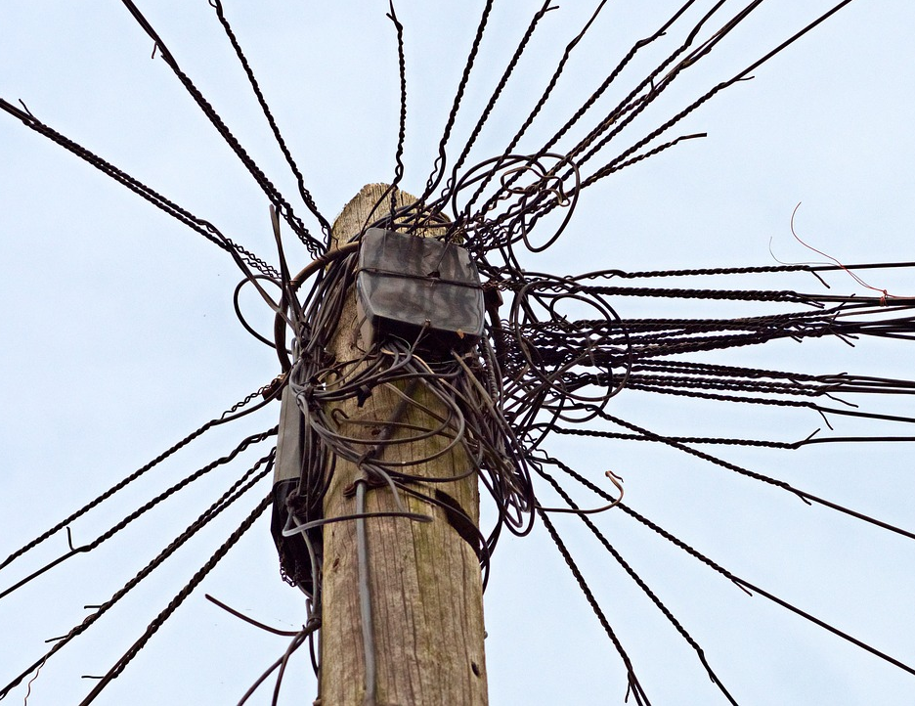
Organising your data
Do not use your computer desktop as a storage place
Make a folder hierarchy and give your folders descriptive and informative names
Avoid folders that become too broad or general, create more subfolders instead.
Keep active and finished parts of your project separate, and take the time to tidy once in a while

Slide 8
Metadata
Image by Gerd Altmann from Pixabay
Notes:
Image by <a href="https://pixabay.com/users/geralt-9301/?utm_source=link-attribution&amp;utm_medium=referral&amp;utm_campaign=image&amp;utm_content=3382516">Gerd Altmann</a> from <a href="https://pixabay.com/?utm_source=link-attribution&amp;utm_medium=referral&amp;utm_campaign=image&amp;utm_content=3382516">Pixabay</a>

Slide 11
Metadata
File name: 2019-10-11 ScreenShot.png
Source: https://kart.finn.no
Year: 1937
Location: Oslo, Blindern
Location_GPS: 59.93760º N, 10.72122º Ø 59° 56′ 15.4″N, 10° 43′ 16.4″Ø
Altitude: 76m

Slide 12
Metadata
Metadata or “data about data” are descriptions that facilitate cataloguing data and data discovery.
Metadata are intended for machine-reading. When data is submitted to a trusted data repository, the archive generates machine-readable metadata.
Machine-readable metadata help to explain the purpose, origin, time, location, creator(s), term of use, and access conditions of research data
Your discipline very likely has standards for metadata!

Slide 13
Design a data file structure
An important part of the metadata is often embedded into the data file, e.g. variable names and variable or value labels.
Therefore, the structure of your data also contributes to the clarity of your data documentation.

Slide 14
Documentation
Image by Gerd Altmann from Pixabay
Notes:
Image by <a href="https://pixabay.com/users/geralt-9301/?utm_source=link-attribution&amp;utm_medium=referral&amp;utm_campaign=image&amp;utm_content=3382516">Gerd Altmann</a> from <a href="https://pixabay.com/?utm_source=link-attribution&amp;utm_medium=referral&amp;utm_campaign=image&amp;utm_content=3382516">Pixabay</a>

Slide 15
Documentation of research data
Systematically documented research data is key to making the data publishable, discoverably, citable, and reusable (and FAIR)
Clear and detailed documentation improve the overall data quality
It is vital to document both the study for which the data has been collected and the data itself. These two levels of documentation are called project-level and data-level documentation

Slide 16
Documentation of research data
The project-level documentation explains the aims of the study, what the research questions/hypotheses are, what methodologies were being used, what instruments and measures were being used, etc.
Data-level or object-level documentation provides information at the level of individual objects such as images or variables in a database/table or transcripts, etc.
It’s become a convention to create various README-files, both for project-level documentation and for data-level documentation

Slide 17
Documentation of research data
Project level
General information about the project
Hypotheses
Methods for collecting and analyzing the data
File or folder level
Folder system
Version control
Lists of files and how they were obtained
List of samples?
Explanation of scripts and sets of programs written
(Naming convention for files)
Variable or experiment level
Description of each variable, with units

Slide 18
Document everything your data has been through
Field journal
Lab journal
Scripts for analysis etc.
Method reports
Geolocation, orientation, etc. when collecting a sample
Instrument settings and calibration
README-files

Slide 19
Quality control of data
There is little point in running a perfect analysis on faulty data
Errors can be caused by both technical and human error
Check for instance:
That sums and partial sums are correct
That units and data formats are consistent across variables
That sample material has been sufficiently processed to get a readout

Slide 20
Notes:
Make your research data as fair as possible

Slide 21
File naming & Folder structure
Image by Gerd Altmann from Pixabay
Notes:
Image by <a href="https://pixabay.com/users/geralt-9301/?utm_source=link-attribution&amp;utm_medium=referral&amp;utm_campaign=image&amp;utm_content=3382516">Gerd Altmann</a> from <a href="https://pixabay.com/?utm_source=link-attribution&amp;utm_medium=referral&amp;utm_campaign=image&amp;utm_content=3382516">Pixabay</a>

Slide 22
File naming & Folder structure
Structuring your data files in folders is important for making it easier to locate and organise files and versions. A proper folder structure is especially needed when collaborating with others.
The decision on how to organise your data files depends on the plan and organisation of the study. All material relevant to the data should be entered into the data folders, including detailed information on the data collection and data processing procedures.

Slide 23
Example of a research project without a data file structure – Edina Pózer ©

Slide 24
How it could look like
Research project with a proper data file structure. Image taken from CodeRefinery, Lesson on Reproducible Research.
https://coderefinery.github.io/reproducible-research/02-organizing-projects/. Shared under CC-BY 4.0.

Slide 25
Naming conventions
Short names, but long enough that they still make sense
The most general info first, then add details to the name
Underscore to separate words, NEVER EVER EVER use space in file names!
Dates backwards (YYYYMMDD)
Numbers (e.g. version number) should have the same number of digits, use e.g. 01, not just 1.
Version number at the end

Slide 26
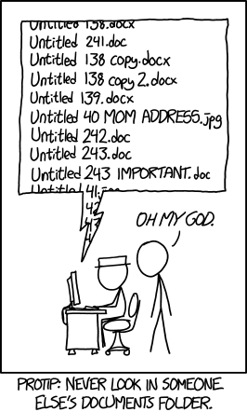

Slide 27
Avoid using the following characters in Folder and File names
# pound
% percent
& ampersand
\ back slash
$ dollar sign
! exclamation point
< left angle bracket
> right angle bracket
/ forward slash
blank spaces
' single quotes
" double quotes
{ left curly bracket
} right curly bracket
* asterisk
? question mark
= equal sign

Slide 28
Also, keep these rules in mind
Don’t start or end your filename with a space, period, hyphen, or underline
Keep your filenames to a reasonable length
Most operating systems are case sensitive; always use lowercase

Slide 29
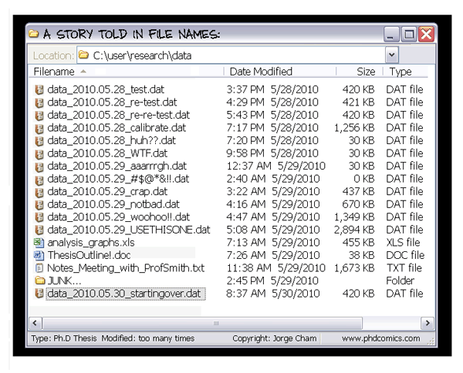
Tidy every once in a while

Slide 30
File format
When your project is finished and you plan on archiving your data, it is widely recommended to transfer data and accompanying files into a more sustainable format
Trusted data archives often have guidelines for this, e.g. the recommendations of Data Archiving and Networked Services (DANS)
https://dans.knaw.nl/en/about/services/easy/information-about-depositing-data/before-depositing/file-formats
Notes:
When you are actively working with research data and other project data, it is often recommended that you follow the conventions for use of software, analytical tools, programs, and data types

Slide 31
Questions & Answers
Image by Gerd Altmann from Pixabay
Notes:
Image by <a href="https://pixabay.com/users/geralt-9301/?utm_source=link-attribution&amp;utm_medium=referral&amp;utm_campaign=image&amp;utm_content=3382516">Gerd Altmann</a> from <a href="https://pixabay.com/?utm_source=link-attribution&amp;utm_medium=referral&amp;utm_campaign=image&amp;utm_content=3382516">Pixabay</a>

Slide 32
Thank you!
Image by Gerd Altmann from Pixabay
Notes:
Image by <a href="https://pixabay.com/users/geralt-9301/?utm_source=link-attribution&amp;utm_medium=referral&amp;utm_campaign=image&amp;utm_content=3382516">Gerd Altmann</a> from <a href="https://pixabay.com/?utm_source=link-attribution&amp;utm_medium=referral&amp;utm_campaign=image&amp;utm_content=3382516">Pixabay</a>

Slide 33
The material for this webinar was partly based on works of Annika Rockenberger & Anne Bergsaker.

