Slide 1
Sharing and archiving research data
Matthew Good, University of Oslo Library
11/11/2020​
Slides by Elin Stangeland

Slide 2
Terminology
Sharing
Archiving
Open
Controlled access
Publishing
Journal
Archive?

Slide 3
Open science
Open science means transparency and knowledge-sharing in research processes to make knowledge accessible across academic groups, sectors and national boundaries. The concept of open science encompasses the entire research process […].
Source: The Research Council of Norway. Policy for open science 2020
Image by: opensourceway

Slide 4
Why open science?
“My main argument for opening all parts of the process is that is “sharpening” the research process. You cannot be sloppy if you know that it will be exposed”. Alexander R. Jensenius, 2020
improved quality of research by building on previous works and compiling research data in new ways
transparency in the research process and better opportunity for verifiability of scientific results
increased cooperation and less duplication of research work
increased innovation in the private and public sectors
efficiency improvement and better utilisation of public funds
Sources: https://www.uio.no/english/for-employees/support/research/research-data-management
/policies-and-guidelines/index.html and https://www.arj.no/2020/08/27/open-research/

Slide 5
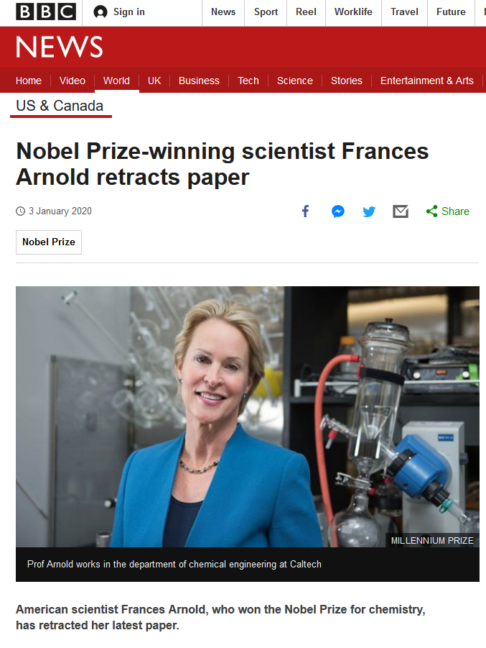
Source: https://www.bbc.com/news/world-us-canada-50989423

Slide 6
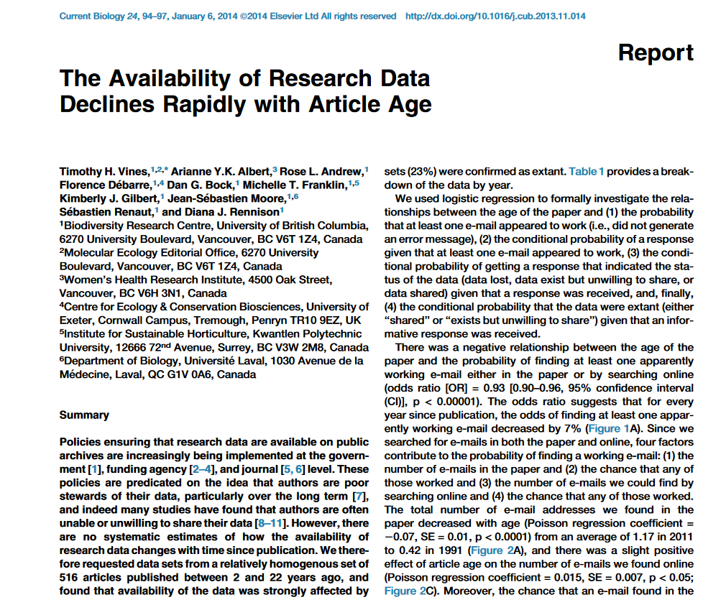

Slide 11
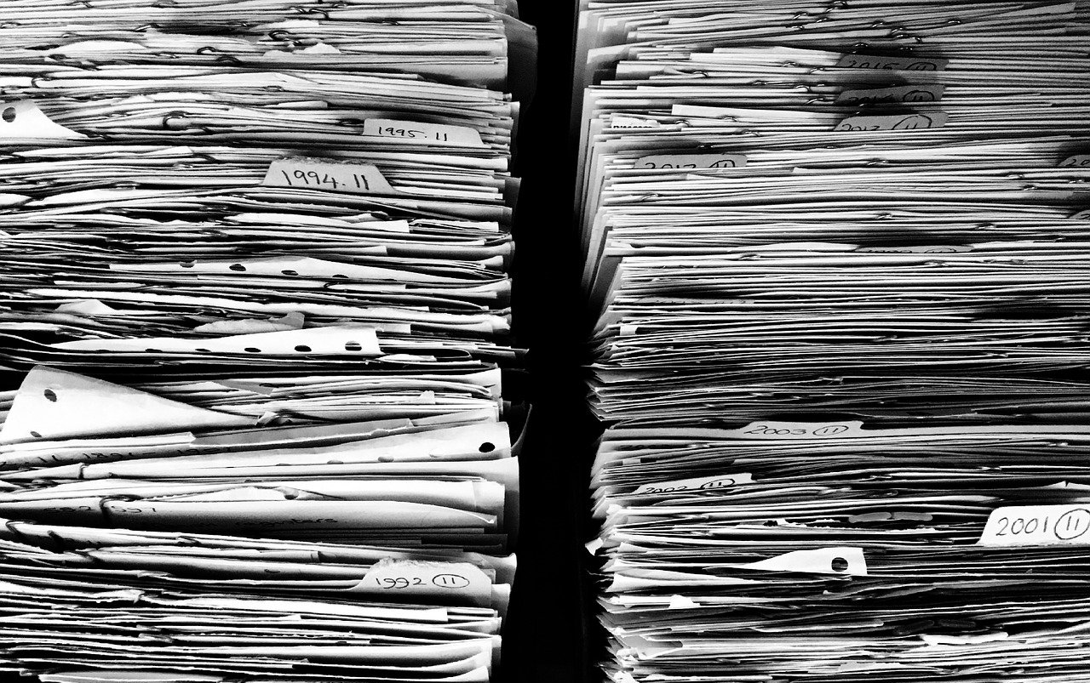
Reasons for sharing your data
Career Benefits
Increased visibility
More reuse
Increased citations
Norms
«This is how we do it here»
External Factors
Funder requirements
Publisher requirements
Scientific Progress
More robust research
Enables new collaborations
Opens up for new uses of data
Avoids duplication
Builds links to younger researchers
Easier to use data in teaching

Slide 13
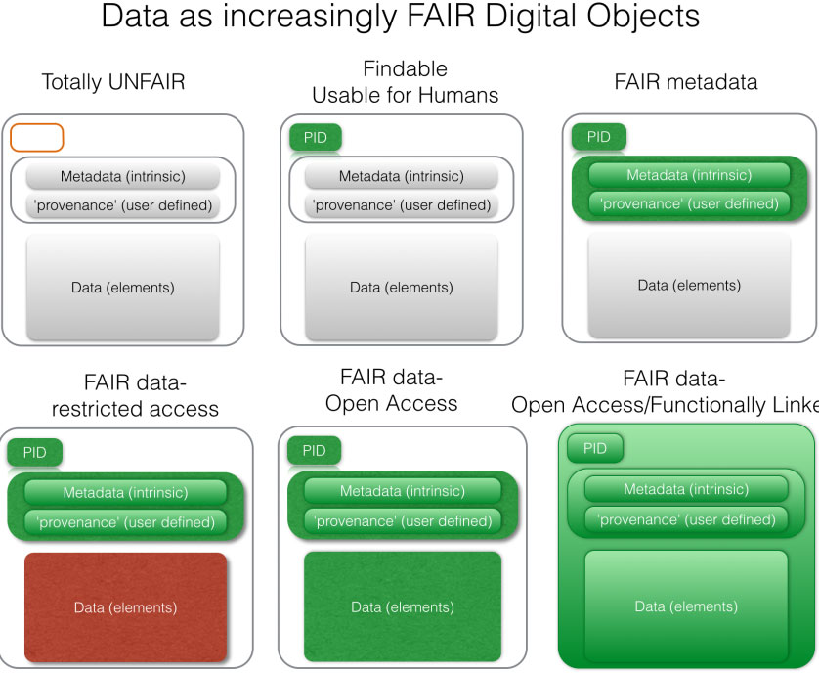
Source: FORCE11.org

Slide 14
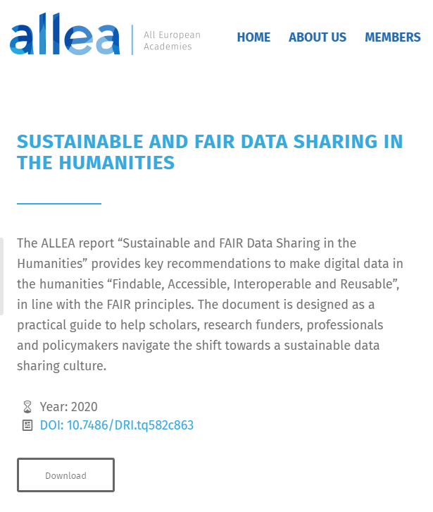
Notes:
https://allea.org/portfolio-item/sustainable-and-fair-data-sharing-in-the-humanities/
https://doi.org/10.7486/DRI.tq582c863
http://training.parthenos-project.eu/sample-page/manage-improve-and-open-up-your-research-and-data/

Slide 15
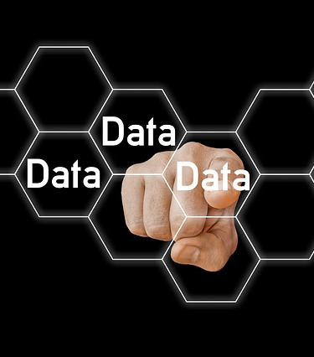
Selecting data for archiving
Does your dataset have reuse potential?
(Inter-)national or historical importance
Quality
Uniqueness or originality
Size, scale, cost
Innovativeness
Is your dataset reusable?

Slide 16
Preparing for archiving
Determine scientific relevance and need for archiving long-term
Consistent, meaningful, and compatible file naming
Choose accessible, patent-free, and open file formats
Make sure you have the necessary documentation (and metadata)
Reduce complexity by grouping large groups of similar files in zip bundles to make upload and download easier
Presence of personal or confidential data can affect choice of archive
Consider size limitations when choosing an archive (e.g. some archives have a limit of 10 to 50 GB per dataset)
Adapted from https://data.4tu.nl/info/fileadmin/user_upload/Documenten/Deposit_Guidelines_2019.pdf

Slide 17
https://dans.knaw.nl/en/about/services/easy/information-about-depositing-data/before-depositing/file-formats

Slide 18
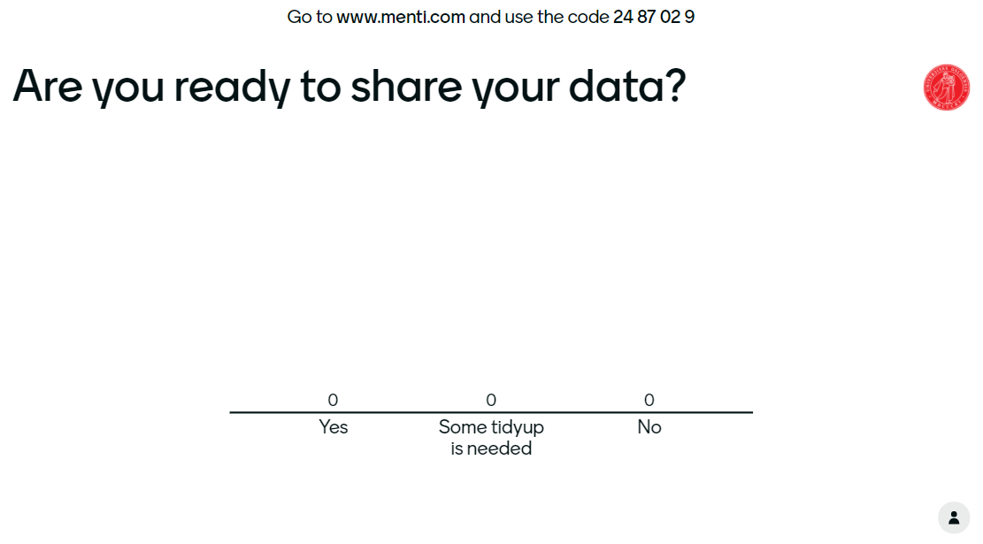

Slide 20
Types of data archives
Domain specific
General purpose
Institutional
Supplementary material to an article
Data paper

Slide 21
Requirements for data to be included in the NSD collection:
The data is digital and is about people and society
Data is valid, reliable and up to date
Data has a reusability value by being well documented and having sufficient contextual material
For qualitative data, permission to archive and share the data with indirect personal identifiers is obtained
Source: https://nsd.no/arkivering/en/

Slide 22
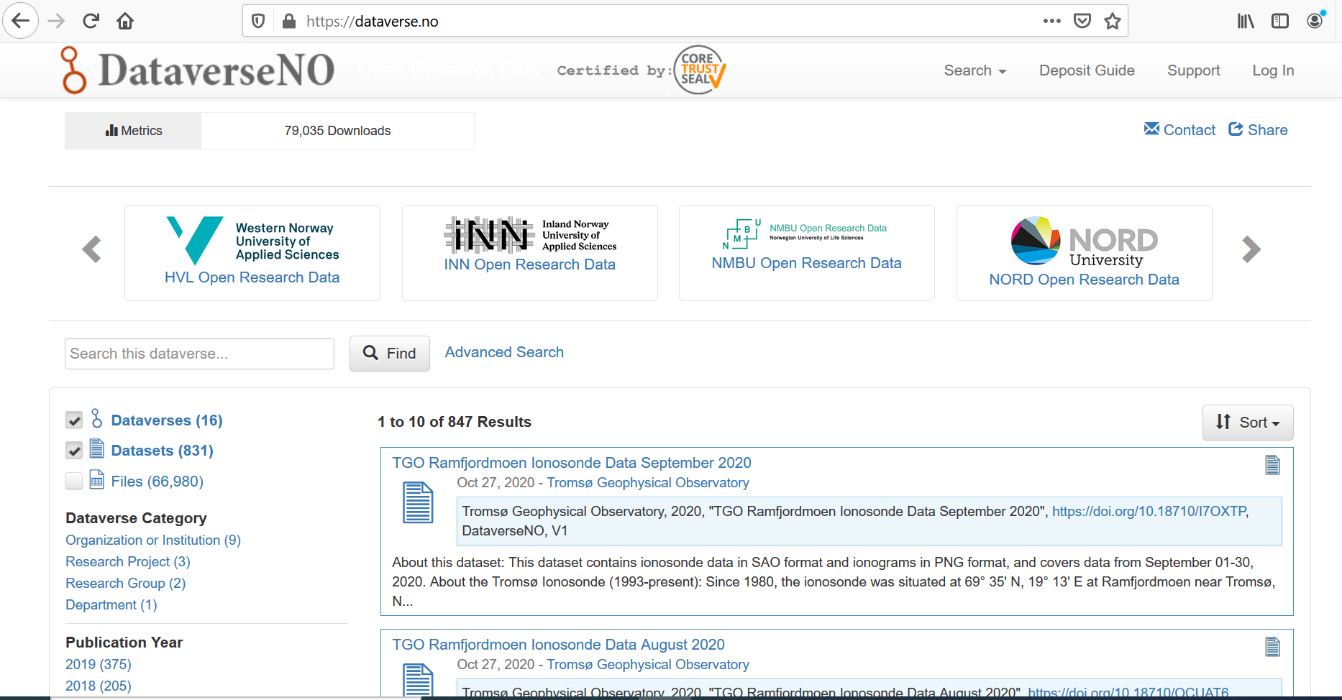

Slide 25
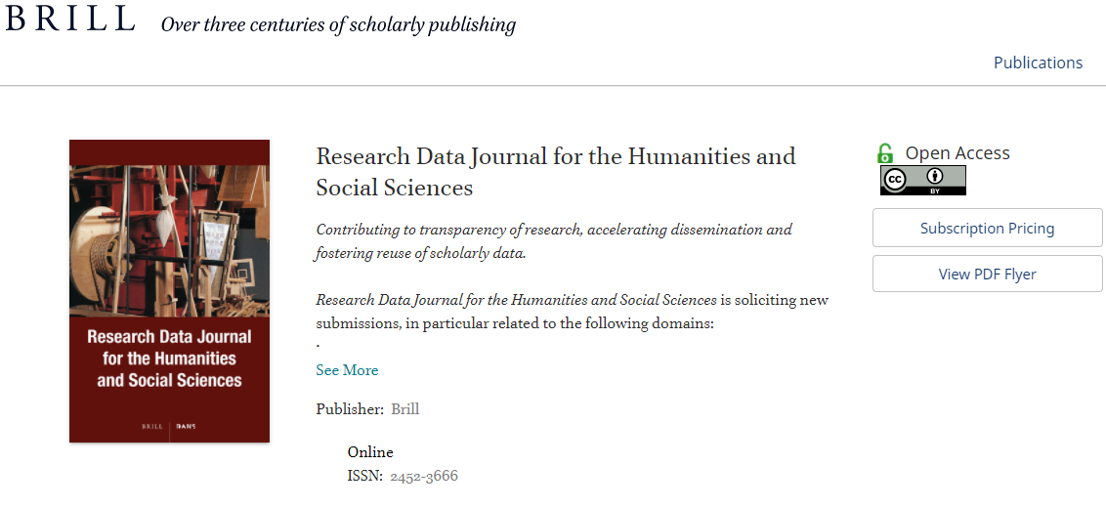
https://brill.com/view/journals/rdj/rdj-overview.xml

Slide 26
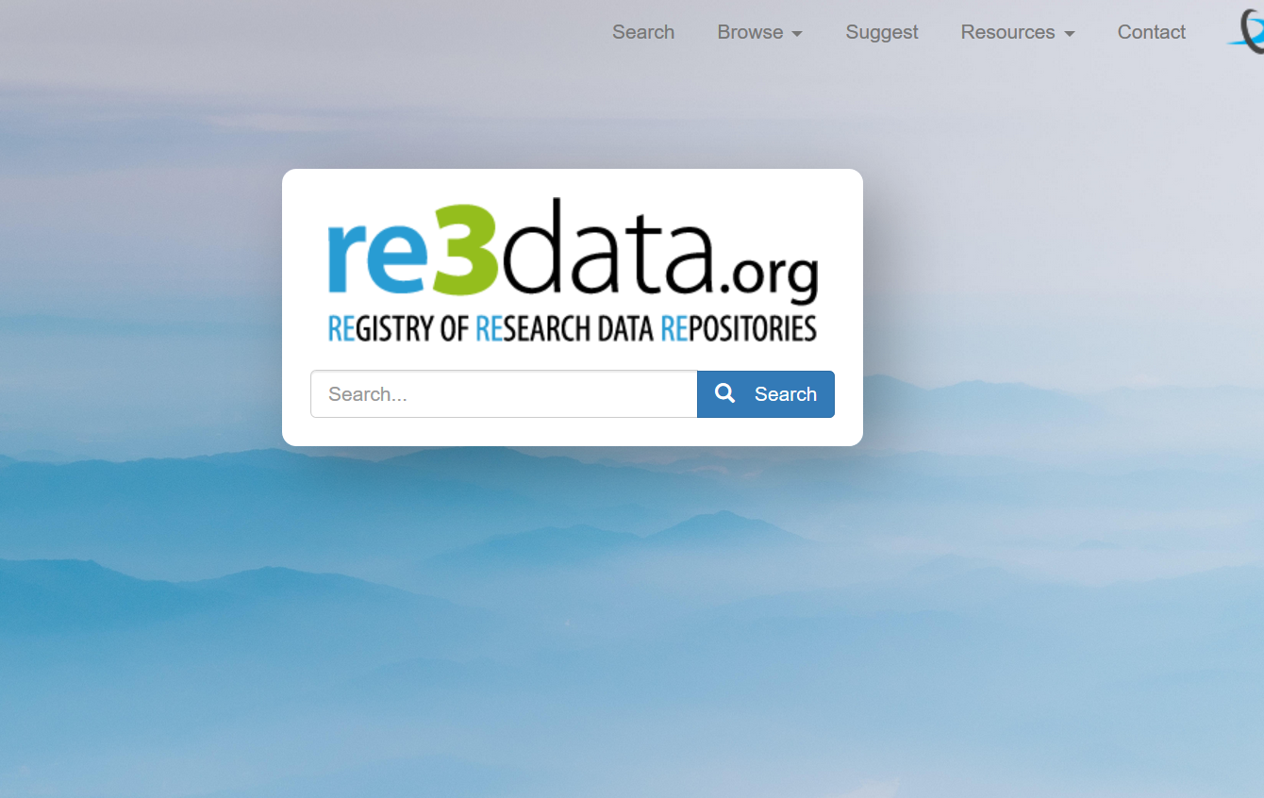

Slide 27
Persistent identifiers (PID)
Published data should have a persistent identifier, a PID.
Eases referencing a dataset – web url’s tend to change/stop working
Common types PID:
Digital Object Identifier (DOI)
Uniform Resource Name (URN)
Permanent Uniform Resource Locator (purl)
Illustration by Jørgen Stamp digitalbevaring.dk CC BY 2.5 Denmark

Slide 28
Licensing your data
A license agreement is a legal arrangement between the creator/depositor of the data set and the data repository, signifying what a user is allowed to do with the data.
Often Creative Commons licenses are often used

Slide 30
Might be the solution at UiO – to be determined
But – there are situations where CC0 are inappropriate
Personal information – for which consent is not cleared
Copyright issues
Orphan works – where rights holders are unknown or cannot be traced

